Slide 1


Pyrenees-Mediterranean SUSTAINABLE AGRI-FOOD INNOVATION DAY
ReyCorks,
Every Cork Counts
2 JULY 2026 – LA CITÉ, TOULOUSE

Slide 2
ReyCorks
Every Cork counts
We Strengthen Wine industry players by enhancing Corks second life. Our unique solutions accelerate Collection, Sorting, Traceability and Corks Valorization
ReyCorks

Slide 3
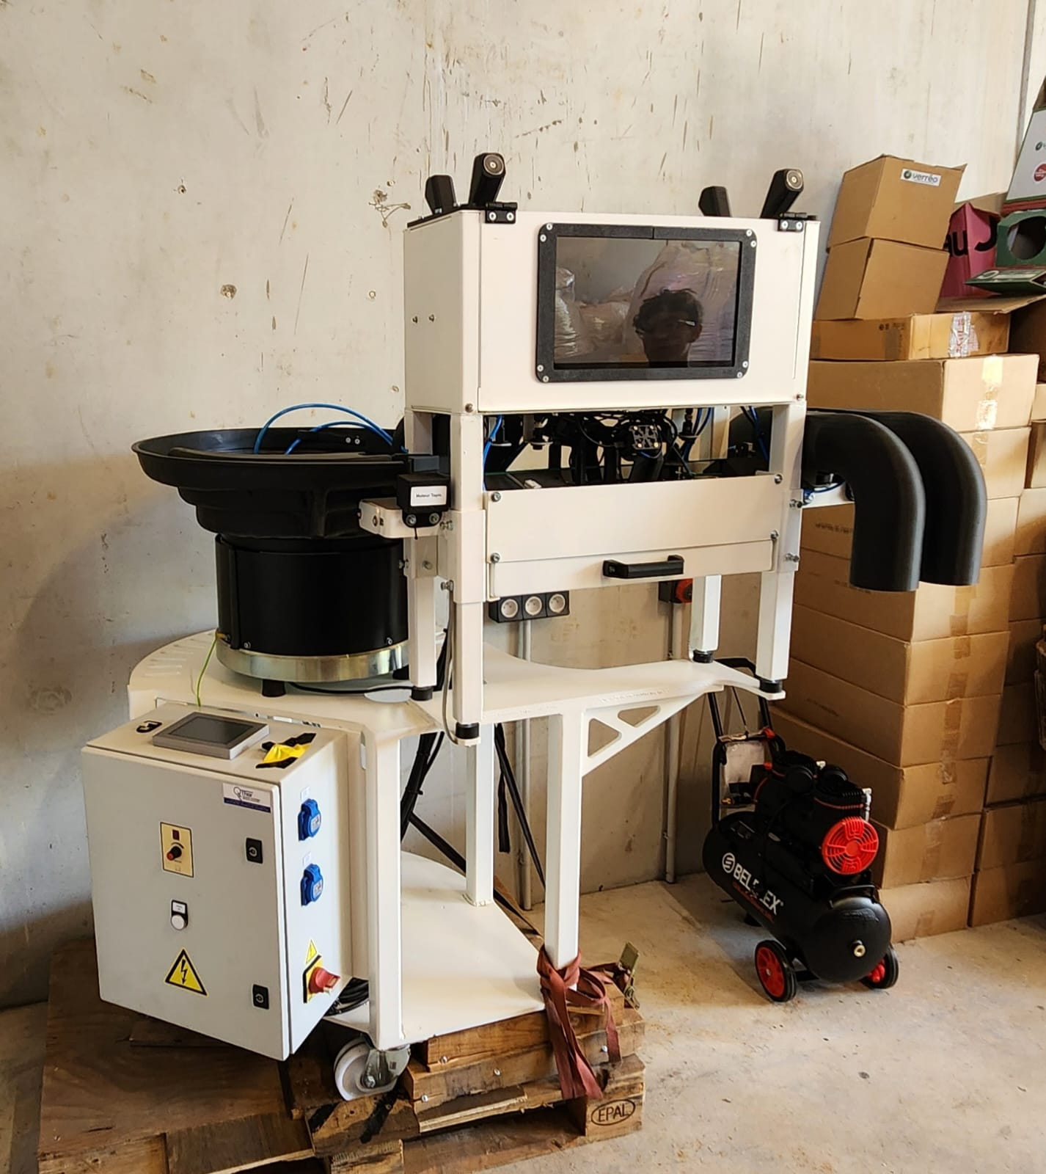
Unique Sorting and Identification Equipment
Sorts corks by type
Counts corks by manufacturers, wine producers and other information
ReyCorks, Every Cork Counts

Slide 4
Commercialization of 2nd life products
ESR Datas
Marketing data (markets shares, wine consumption)
Non alimentary products (eco friendly building products, Luxury, Corks collection tools)
Alimentary products (Research and Development to be continued)
Clients :
Corks manufacturers
Wine Producers
Recycling companies and organisations
Wine selling Points
ReyCorks

Slide 5
Merci Ad’Occ, Euroregion and
EUROPE !!!!!!
Questions ?
ReyCorks

