Slide 1


Pyrenees-Mediterranean SUSTAINABLE AGRI-FOOD INNOVATION DAY
FoodSensing 4CE
2 JULY 2026 – LA CITÉ, TOULOUSE

Slide 2




The Challenge
MANUFACTURER
TRANSPORT
DISTRIBUTION
RETAIL
In house
Out of the factory
LIMITATIONS OF IN-HOUSE QUALITY CONTROLS
sampling → non-reliable 100%
expensive → personnel & maintenance
destructive → non-sustainable
Manufacturers lose track once products leave the factory
CHALLENGES IN DISTRIBUTION AND RETAIL
Expiry dates too conservative → edible food wasted
Discounts before expiry reduce profitability
Unsold products withdrawn and destroyed
Retail only checks dates and appearance
Cold chain breaks only randomly monitored
Spoiled products may reach consumers → health & reputational damage
FoodSensing 4CE

Slide 3

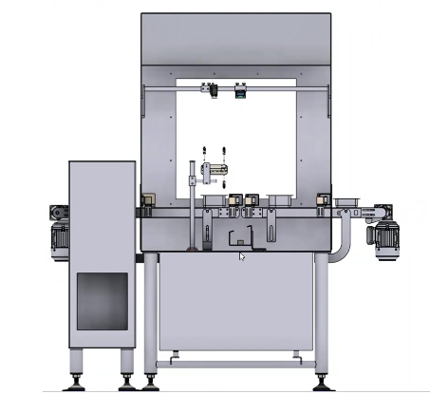






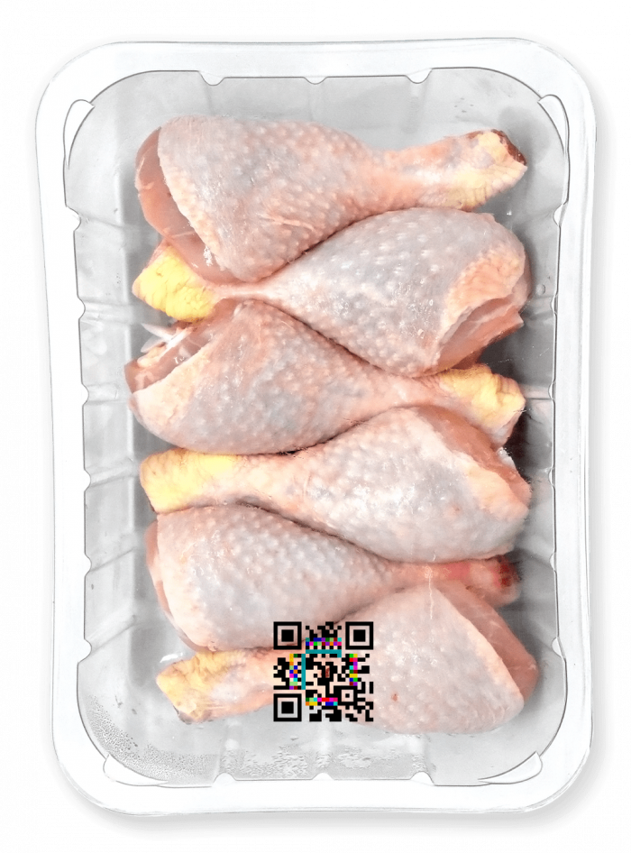
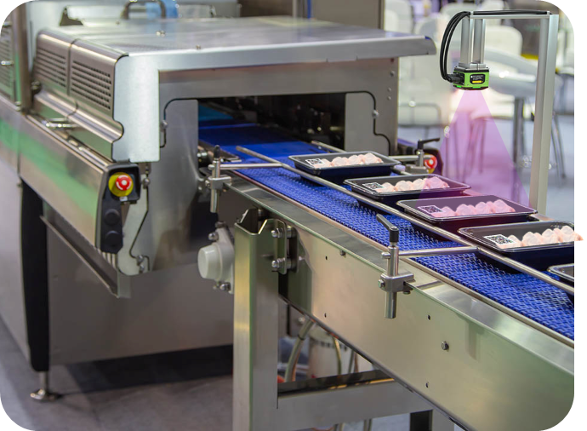


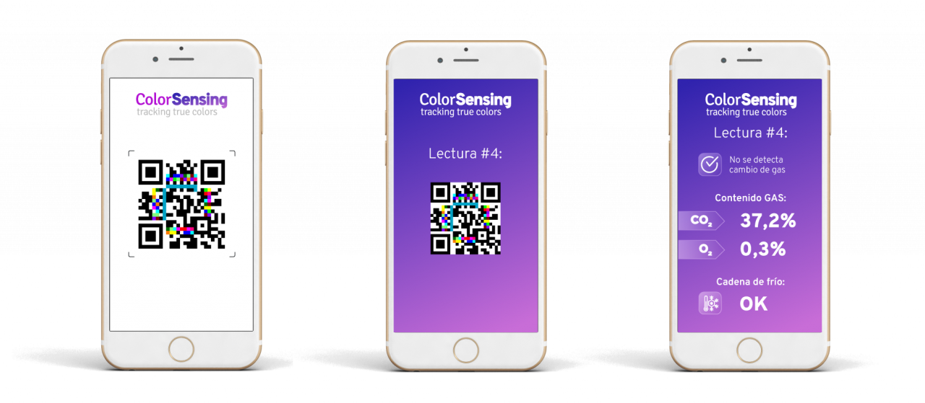



Our Solution
Smart inks: printed
chemical colorimetric sensors
MANUFACTURER
TRANSPORT
DISTRIBUTION
RETAIL
WO2019145390A1
FoodSensing 4CE

Slide 4
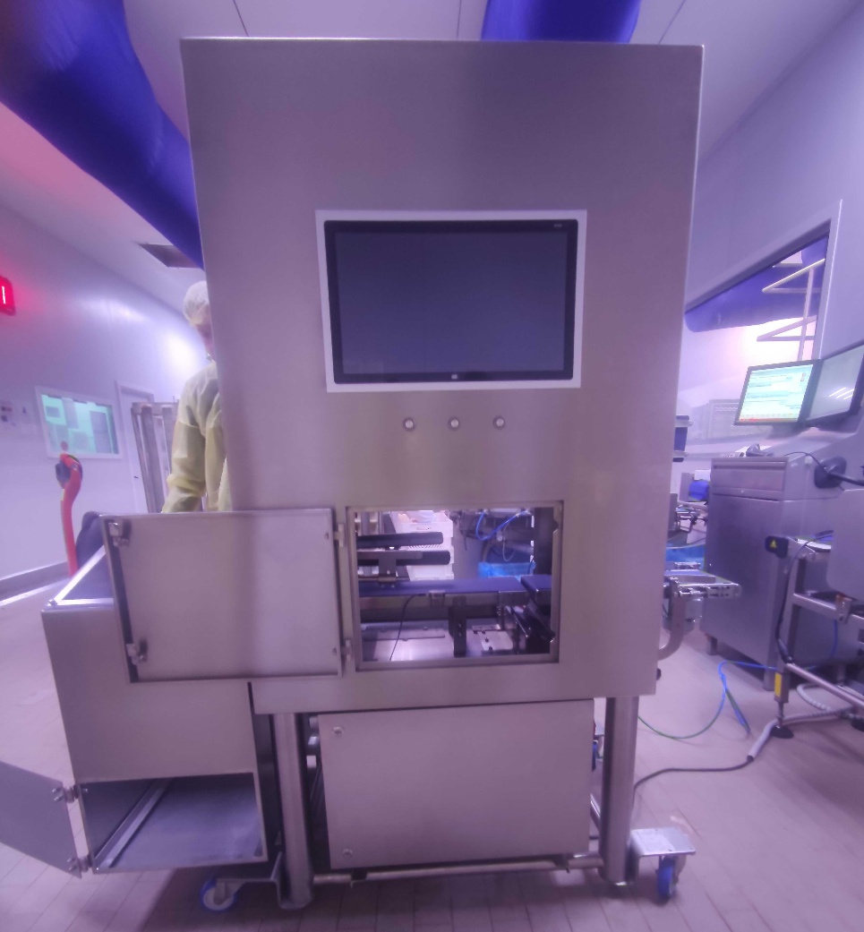
Pilot Phase: Methods
Representative Sample
A comprehensive study was conducted using 60 trays (30 properly sealed and 30 with leaks) packaged in a 20% CO2 environment, ensuring statistical significance.
Real-world variables
Extended monitoring
Leak analysis at various locations (near and far from the sensor) and at different times (early and late) to validate robustness in any scenario.
Continuous monitoring from minute 0 through 14 days, capturing the complete kinetics oft he sensor’s performance.
Non-invasive
Monitoring of 100% of packaged food
Operation in an industrial environment
FoodSensing 4CE

Slide 5
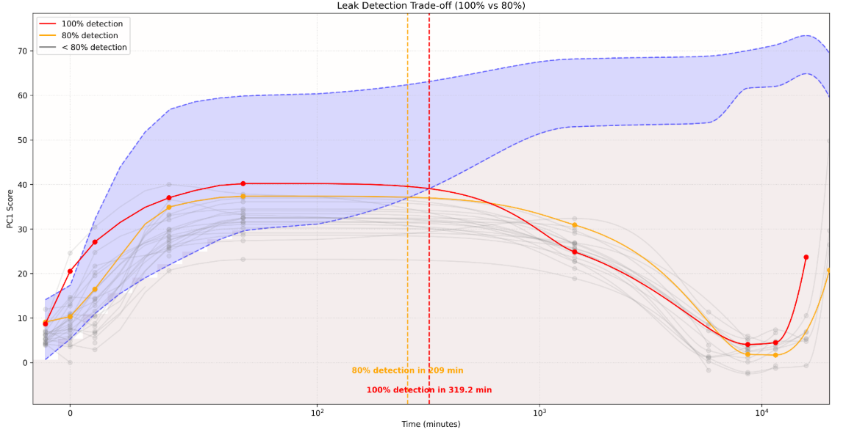
Pilot Phase: Main Results
Reliable leak detection.
Detection of abnormal candidates at the very start.
Rapid detection of late-stage leaks in < 9 minutes.
Post-Packaging Control: Complete security throughout the supply chain, from the factory floor to the final point of sale.
FoodSensing 4CE

