Slide 1



Pyrenees-Mediterranean SUSTAINABLE AGRI-FOOD INNOVATION DAY
FertiByPRO BIO
2 JULY 2026 – LA CITÉ, TOULOUSE
Notes:
Ethicae : Project leader, organic fertilizer producer, factory processing and trials in France.
Akinao : Specialized natural product laboratory, compounds analyses and plant assays.
Majusti : New organic technical sales services, market analysis and trial in Catalonia.

Slide 2
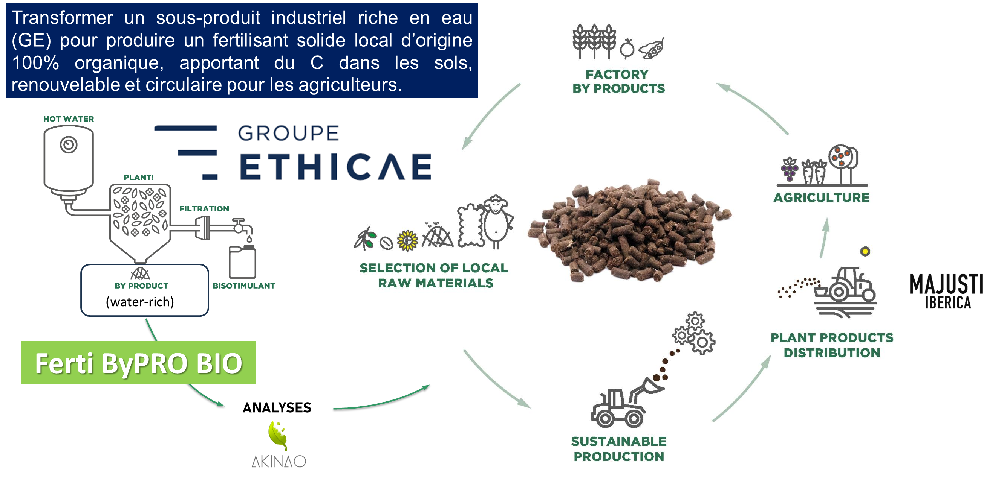
PROJECT ACRONYM

Slide 3
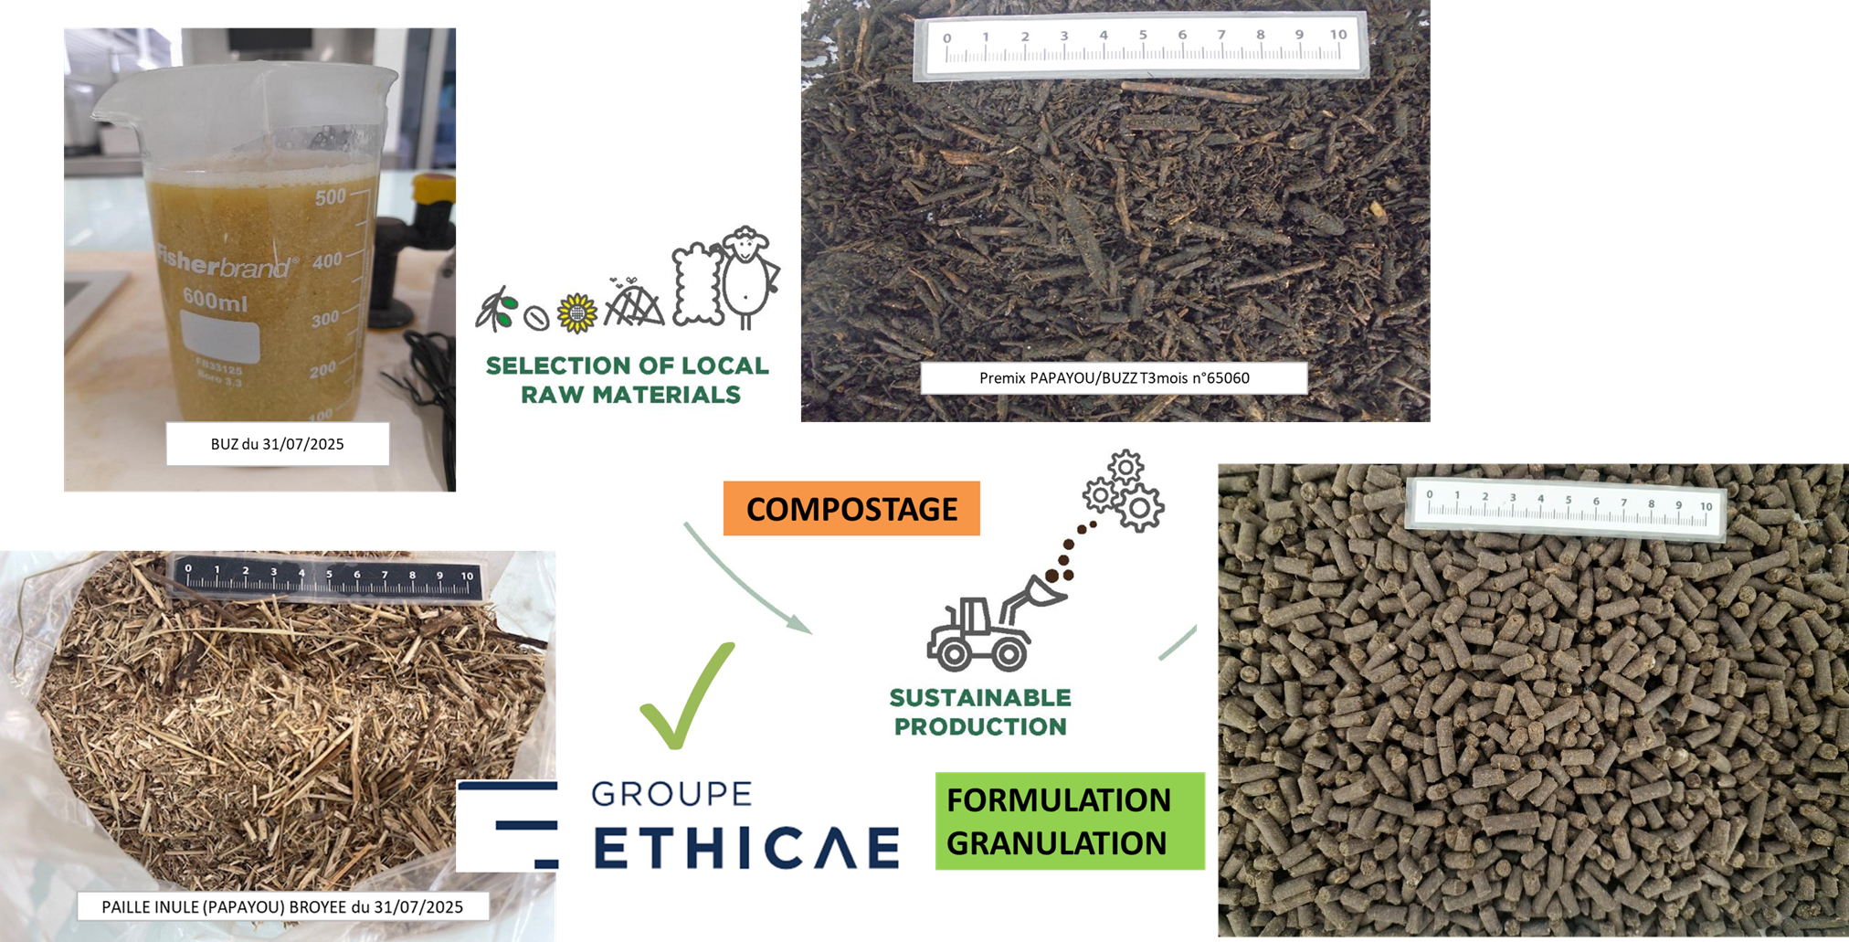
FertiByPRO BIO

Slide 4
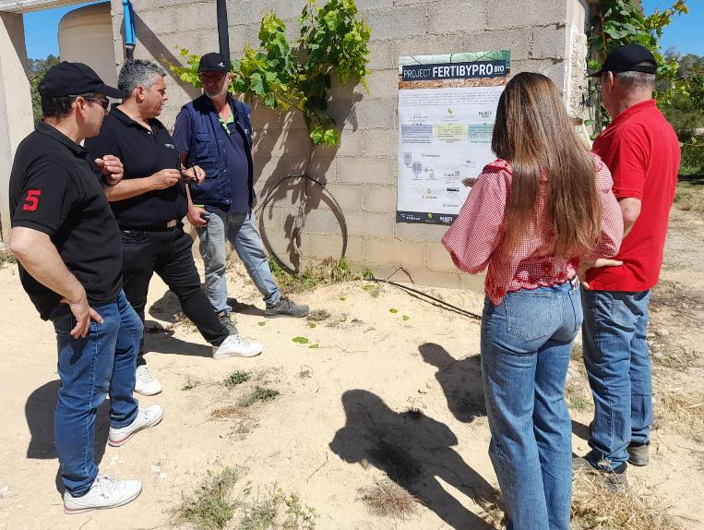
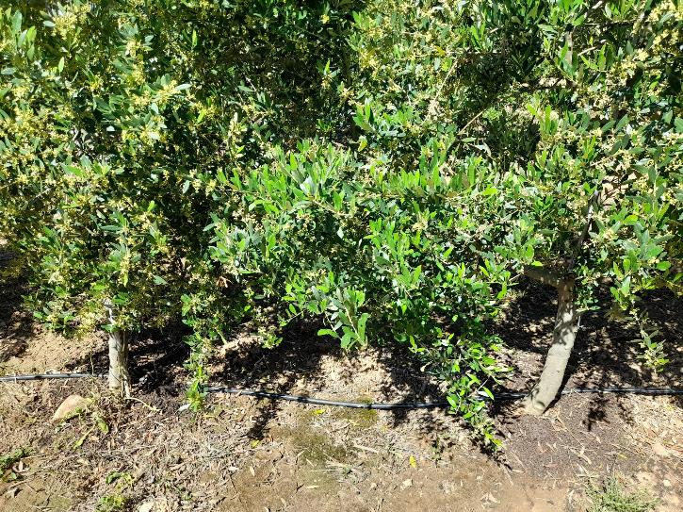
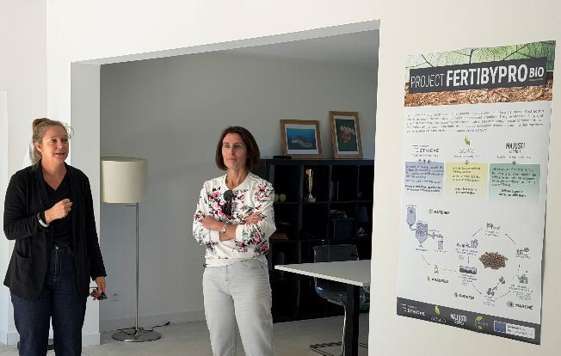
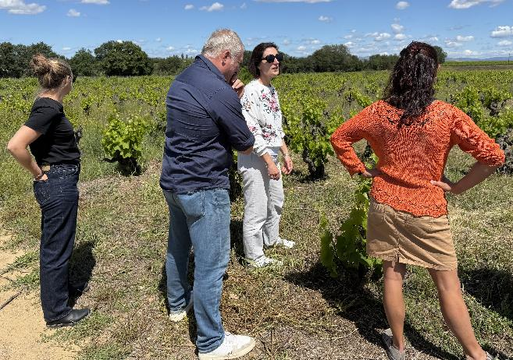
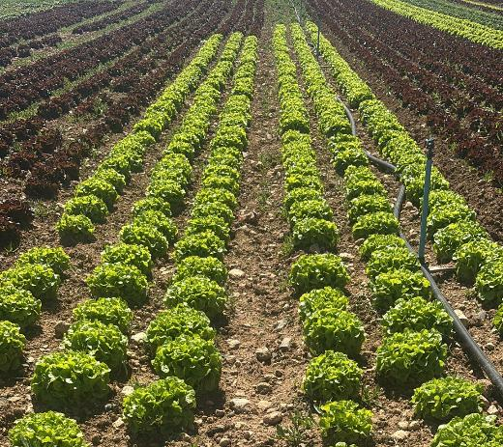
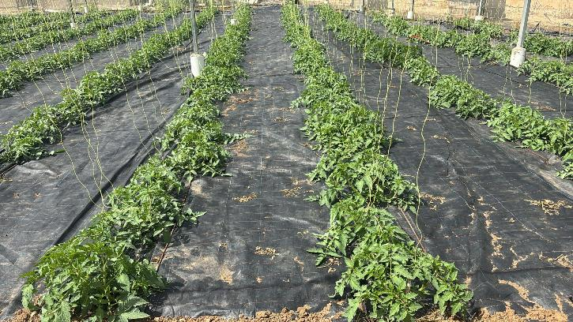
11 et 12 mai 2026 : JTECH Communication FERTI BYPRO BIO
- 1 journée Ponteilla (FR, 66)
- 1 journée Région Tarragone (ES)
Intérêt de la solution validé au champ
FertiByPRO BIO

Slide 5
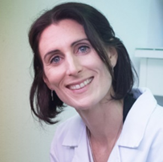
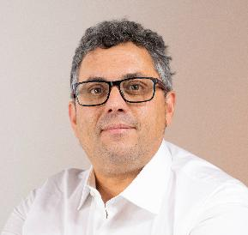
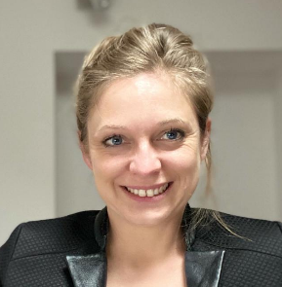
Thanks for your attention
Contact Ethicae group :
Marie-Emmanuelle SAINT-MACARY
me.saint-macary@frayssinet.fr
Contact Majusti Iberica partner:
Xavier Paula-Sastre
contact@majusti.es
Contact AkiNaO partner:
Annabel LEVERT
annabel.levert@akinao-lab.com
FertiByPRO BIO

