Slide 1
Pyrenees-Mediterranean SUSTAINABLE AGRI-FOOD INNOVATION DAY
ECOALJIBE
2 JULY 2026 – LA CITÉ, TOULOUSE

Slide 2
Cleaning a drinking water tank today means throwing it away
Hotels, apartments, residences and collective-use buildings are required to periodically clean and disinfect their drinking water storage tanks (RD 487/2022 — Legionella control).
The conventional procedure requires emptying the tank: the stored drinking water is discharged into the drain. In a single cleaning, the water can be drained up to 3 times
In a Mediterranean region with water stress, this is drinking water wasted year after year.
ECOALJIBE

Slide 3
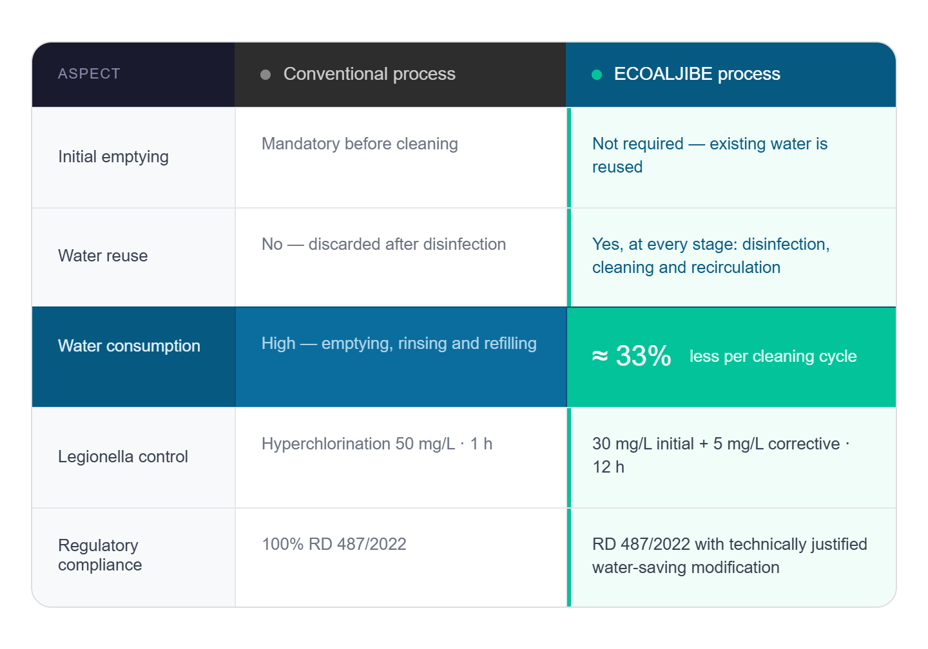
The same sanitary outcome, with one third less water
ECOALJIBE

Slide 4
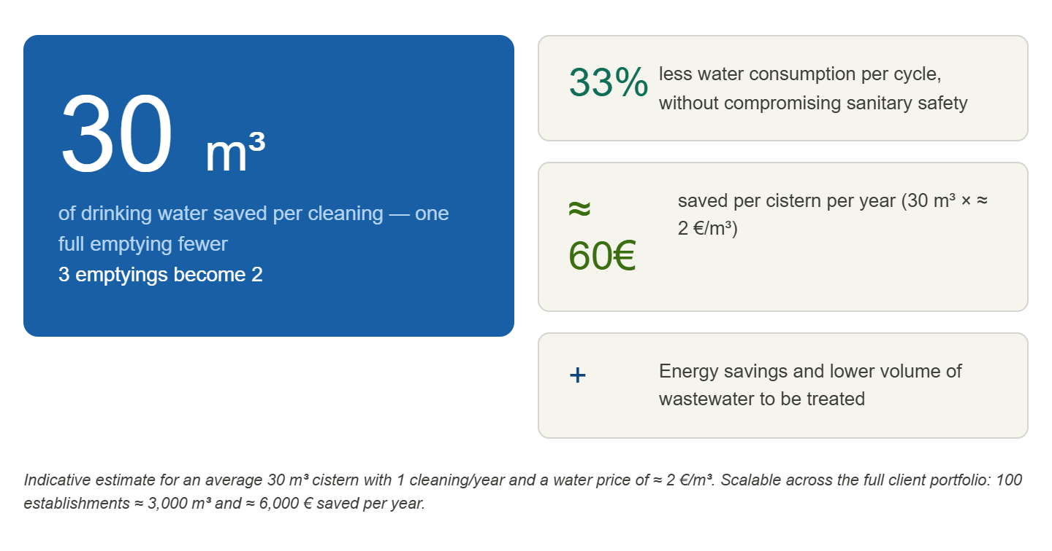
Every cleaning saves a full tank of potable water
ECOALJIBE

Slide 5
ECOALJIBE demonstrates that the cleaning and disinfection of drinking water cisterns can be carried out without emptying them, reducing the number of emptyings by one third and saving 33% of water, while maintaining the same sanitary guarantees and without any additional investment.
ECOALJIBE

