Slide 1
















Pyrenees-Mediterranean
SUSTAINABLE AGRI-FOOD INNOVATION DAY
SOLVENT FREE FLOCCULANT TECHNOLOGY FOR DEWATERED SLUDGE REUSE IN AGRICULTURE
2 JULY 202–6LA CITÉ, TOULOUS

Slide 2
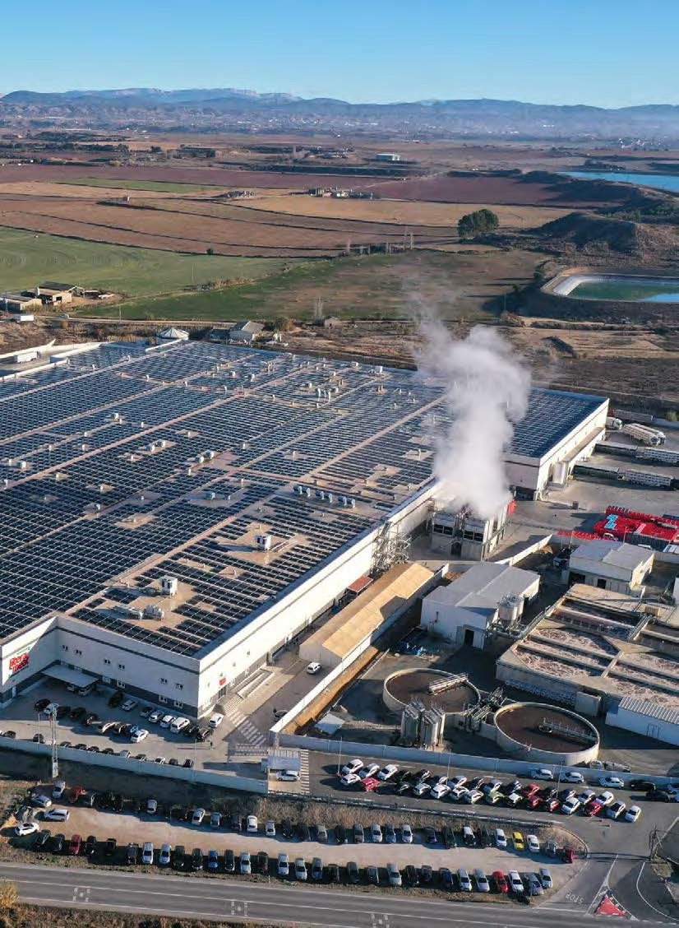
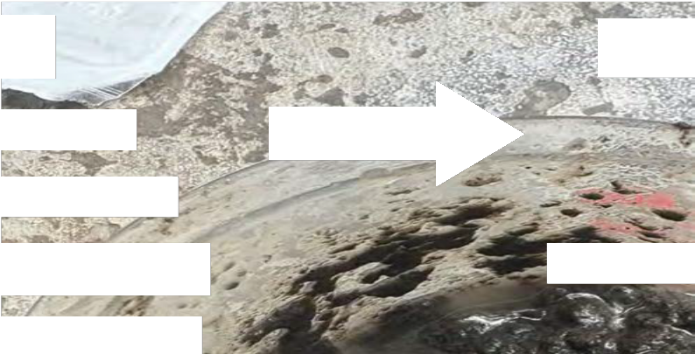












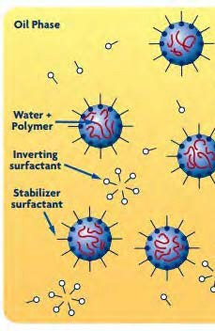
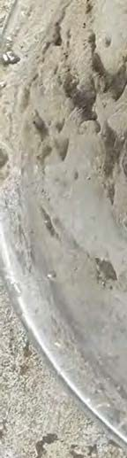
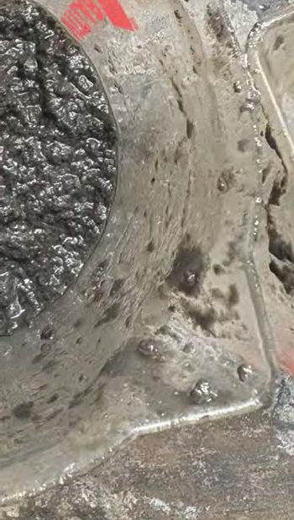
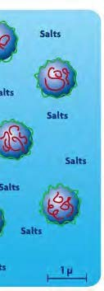
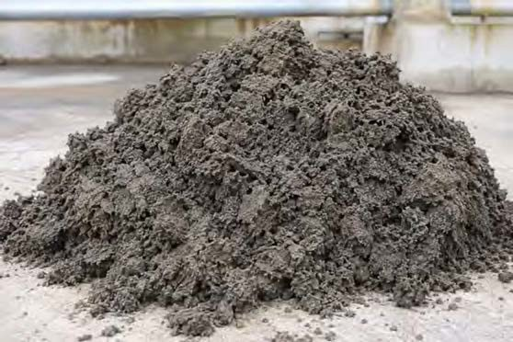
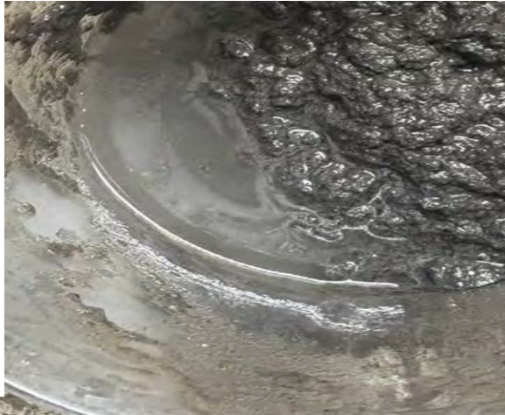


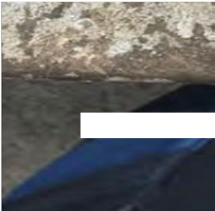



TThheeTrCiahlailnletnhgeela/ rTgheestNSeleadughterhouse in Spain
¿Could we dewater
6 to 12 Mill
Tn/Year Dewatered Sludge in EU
https://ec.europa.eu/eurostat/en/web/prod
20-50
%
sludge safer and with higher nutrient recovery?
Water Based Flocculants
sludge
safer
Use Oil-Ba ed Emulsion fo the Sludge Dewatering
higher n
sed
r the
recove
ering
Water Based F
SOLVENT FREE FLOCCULANT TECHNOLOGY FOR DEWATERED SLUDGE REUSE IN AGRICULTURE
SOLVENT FREE FLOCCULANT TECHNOLOG
ucts-eurostat-news/w/ddn-20240927-2
REUSE IN AGRICUL

Slide 3


We don’t want to add Oils/Solvents to the Sludge for Agriculture.
Measurement of Oil/Solvents in the Sludge after Dewatering
Bodegas Ayuso
Litera Meats
14000
12000
12000
10000
10000
8000
With Oil-Based Emulsion 80% of the solvent end in the Sludge.
8000
6000
6000
4000
4000
2000
With HIMOLOC Water Based we are not adding any solvents
2000
0
Raw Sludge Himoloc Emulsion Sum of mineral oil (ppm)
C10 - C20 (ppm)
Petrogenetic conc C10-C20 (ppm)
0
Raw Sludge Himoloc Emulsion Sum of mineral oil (ppm)
C10 - C20 (ppm)
Petrogenetic conc C10-C20 (ppm)
SOLVENT FREE FLOCCULANT TECHNOLOGY FOR DEWATERED SLUDGE REUSE IN AGRICULTURE

Slide 4
How about the biodegradability of the sludge?

Slide 5
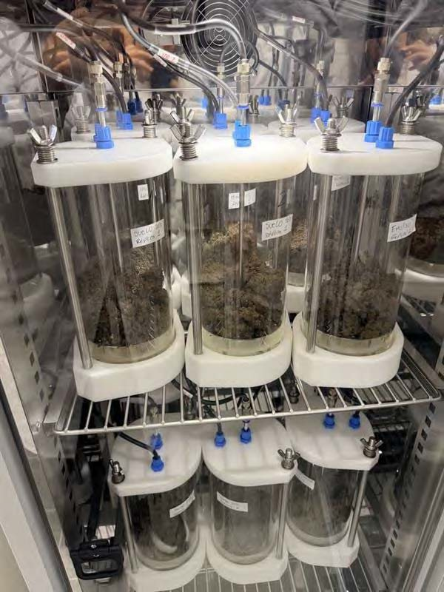

Let’s evaluate the effect on recovering Nutrients.
Thermogravimetric evaluation of sludges and polymers
Parameter | Untreated Sludge | Sludge-HIMOLOC | Sludge-Emulsió
Total Nitrogen (%) | 0,47 | 1,93 | 1,53
Organic Nitrogen (%) | 0,32 | 1,25 | 1,01
Ammonia nitrogen (%) | 0,15 | 0,69 | 0,52
Phosphorus (P₂O₅) (%) | 0,24 | 1,03 | 0,89
Acid humic (%) | 1,4 | 6,9 | 4,5
Total humic ext. (%) | 2,6 | 11,7 | 8,0
Zinc (Zn) mg/Kg s.m.s. | 669 | 646 | 803
E. coli (ufc/g) | 570000 | 2900 | 42000
Respiratory Activity AT4 (mg O₂/g ms) |  | 6,28 | 14,94
The HIMOLOC Treated Sludge
Has higher agronomic value: more nitrogen, phosphorus, humic acid, and humic extract
lower zinc, much lower E. coli, and lower respiratory activity, which point to better safety and stability.
PROJECT ACRONYM

Slide 6
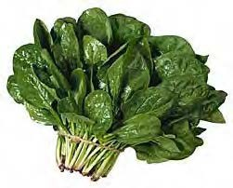
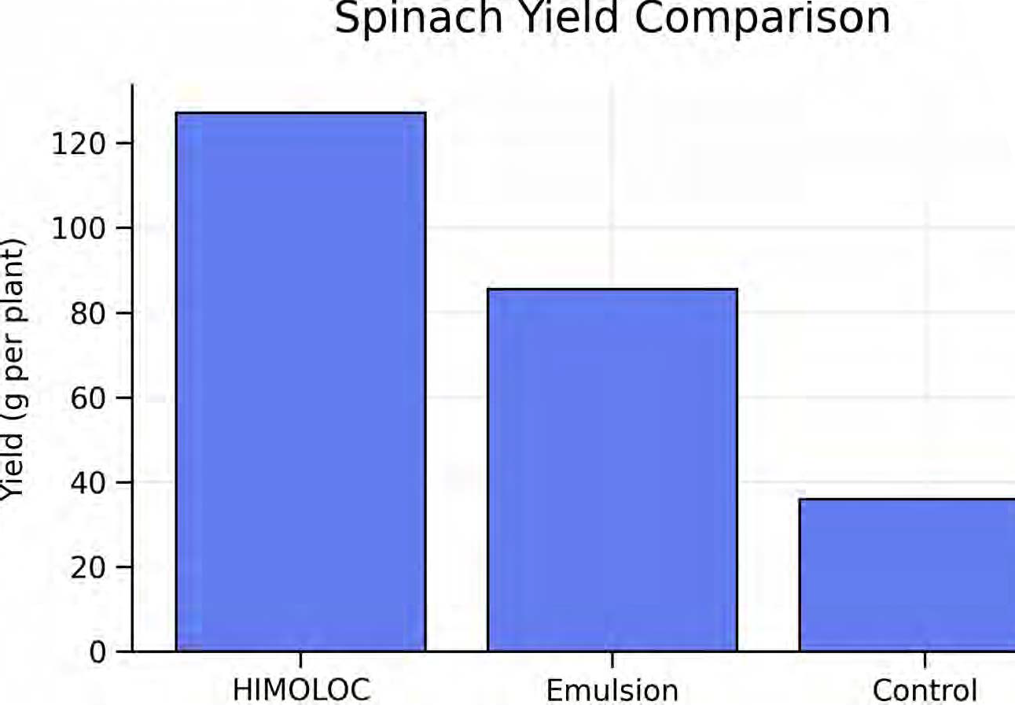


Let’s GO to the Field with Spinach's!
+49%

Slide 7
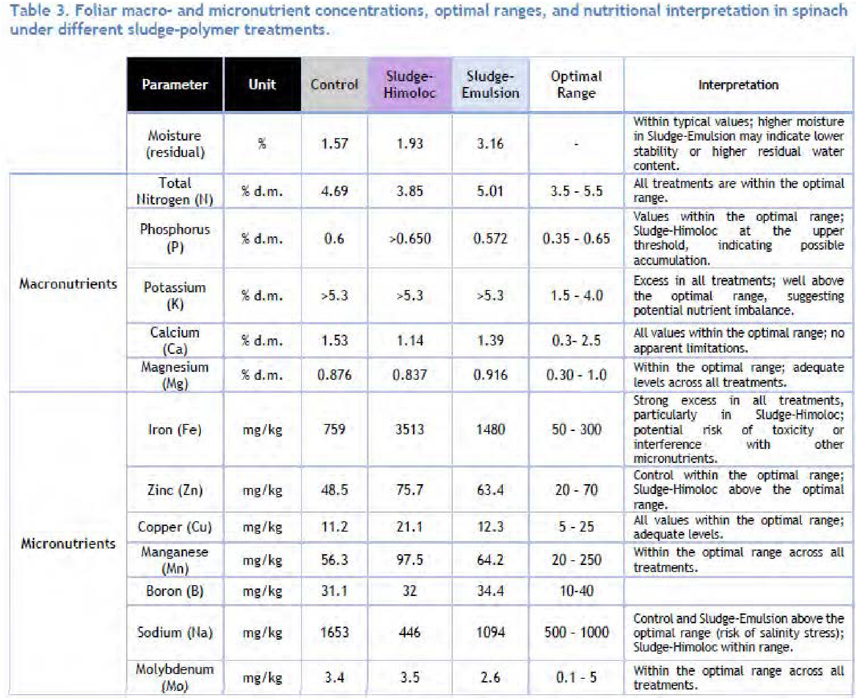
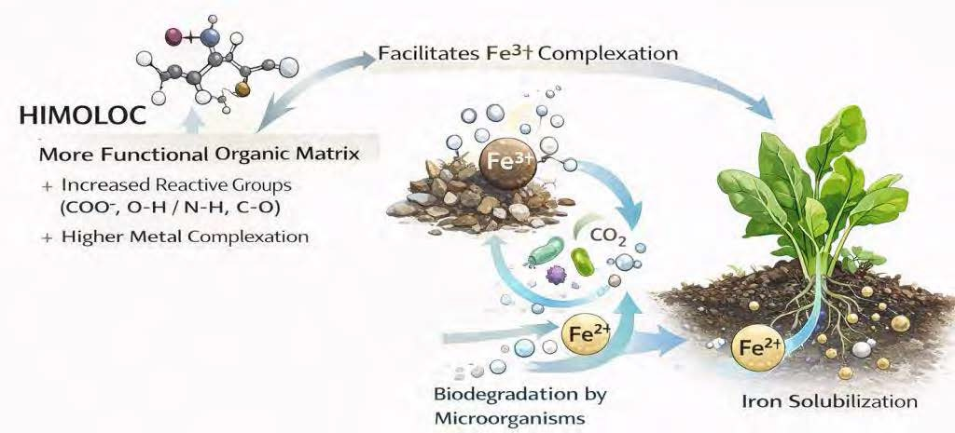

Let’s analyze the foliar parameters.
From an
agronomic
perspective,
the enhanced
availability
of nutrients
and micronutrients
under
sludge treatments
represents a clear
benefit,
contributing
to and
as reflected in earlier harvest and
improved plant nutrition
performance,
increased vegetative growth.
The results demonstrate that the type of polymer used in sludge conditioning plays a crucial role in controlling soil–plant interactions. Sludge-Himoloc, characterized by higher organic matter reactivity and biodegradability, promotes a more dynamic system with enhanced nutrient cycling and metal bioavailability.

Slide 8
Final Summary:
HIMOLOC Water Based Flocculants have demonstrated:
  Not adding solvents/hydrocarbons to the dewatered sludge
  Increase biodegradability
  Promotes microbial activity and faster stabilization
  Promoted fungal diversity and is compatible with seed germination
  Higher agronomical value
  Better safety and stability
  Higher production yield (+49% in Spinachs)
  More dynamic system with enhanced nutrient cycling and metal bioavailability.
We have started with the largest slaughterhouse of Spain (now a customer) but there is still 6 to 12 Mill Tn of Dry Sludge in Europe to change the paradigm!

