Slide 1
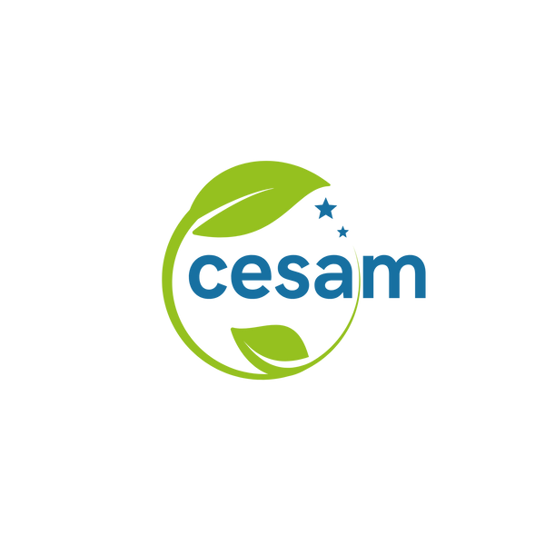

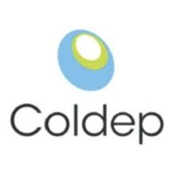


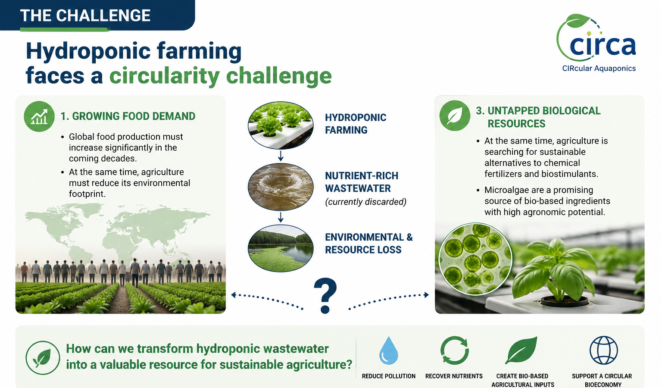
CIRCA: Advancing Circular Agriculture through Hydroponic Wastewater
and Microalgae Cultivation
Notes:
Hydroponic agriculture is one of the most efficient production systems available today. However, it still generates nutrient-rich wastewater that is usually treated as a waste stream. At the same time, farmers are looking for more sustainable alternatives to conventional fertilizers and biostimulants. CIRCA was created to connect these two challenges by transforming wastewater into a valuable biological resource

Slide 2
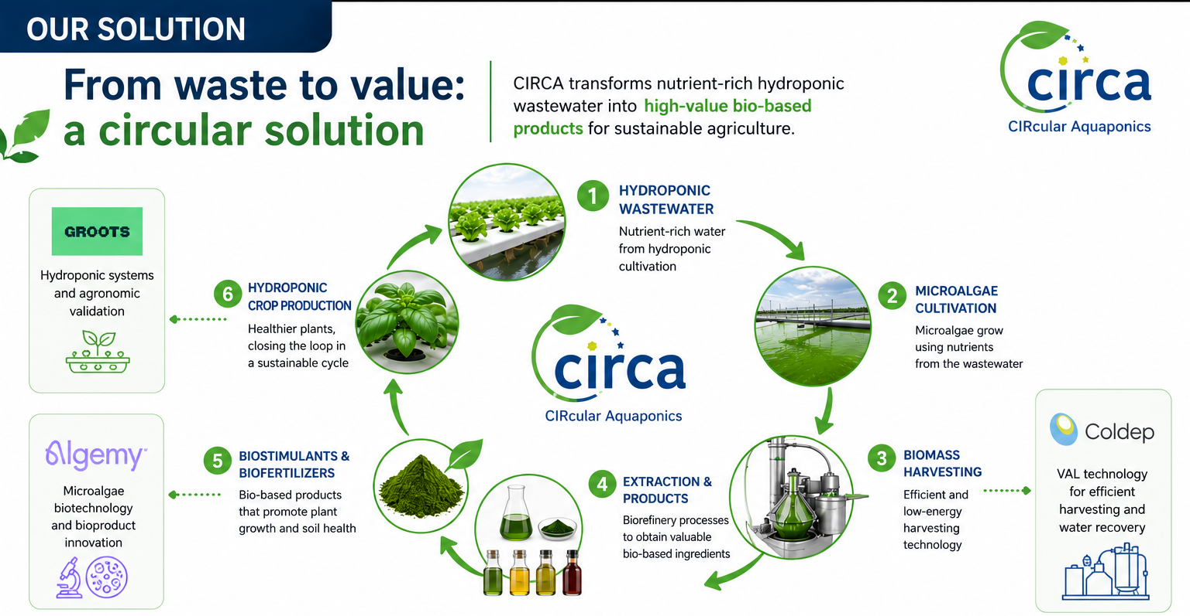
ADD TEXT
Notes:
CIRCA transforms hydroponic wastewater into high-value agricultural products through an integrated circular bioeconomy approach.

Slide 3
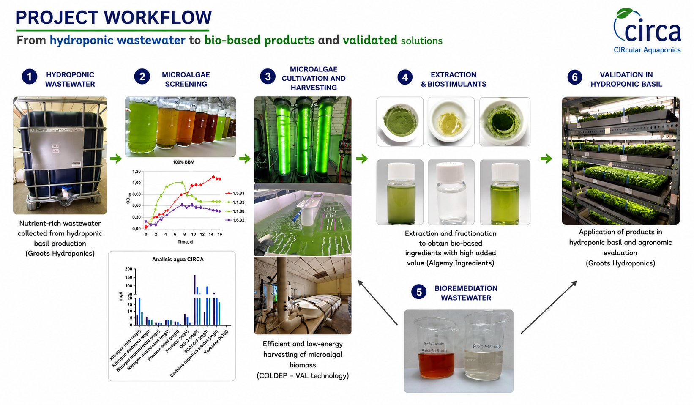

Slide 4
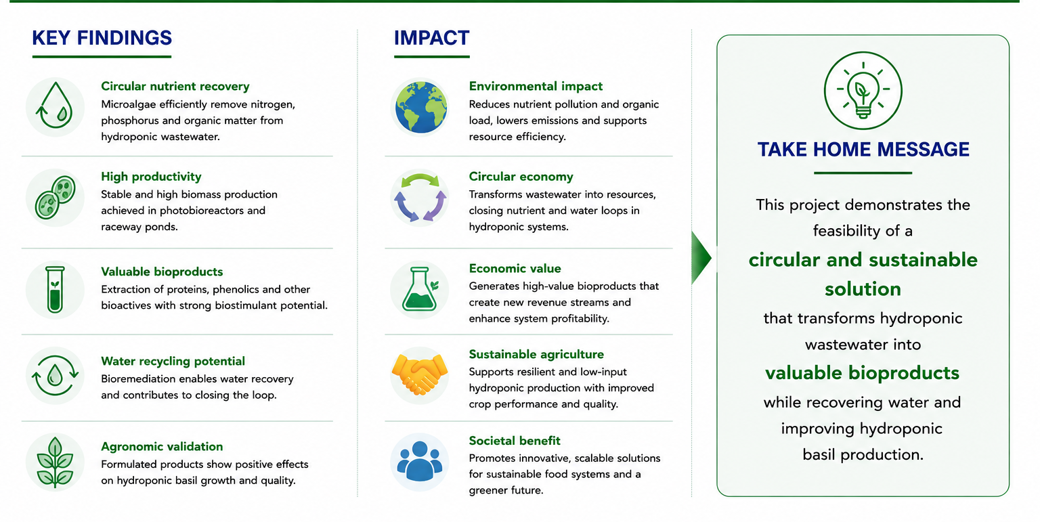
Notes:
CIRCA transforms hydroponic wastewater into high-value agricultural products through an integrated circular bioeconomy approach.

Slide 5
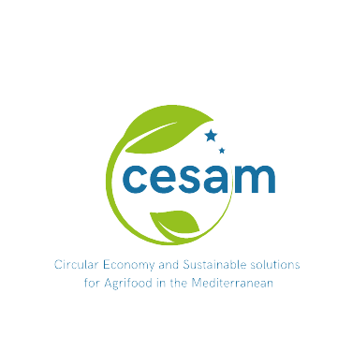
Thank you!
Questions?
esther@algemy.eu
www.algemy.eu

