Slide 1

Pyrenees-Mediterranean SUSTAINABLE AGRI-FOOD INNOVATION DAY
AWARE
Awayter Refill Ecosystem
2 JULY 2026 – LA CITÉ, TOULOUSE

Slide 2
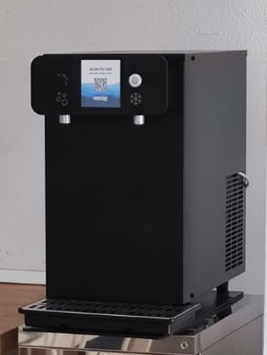

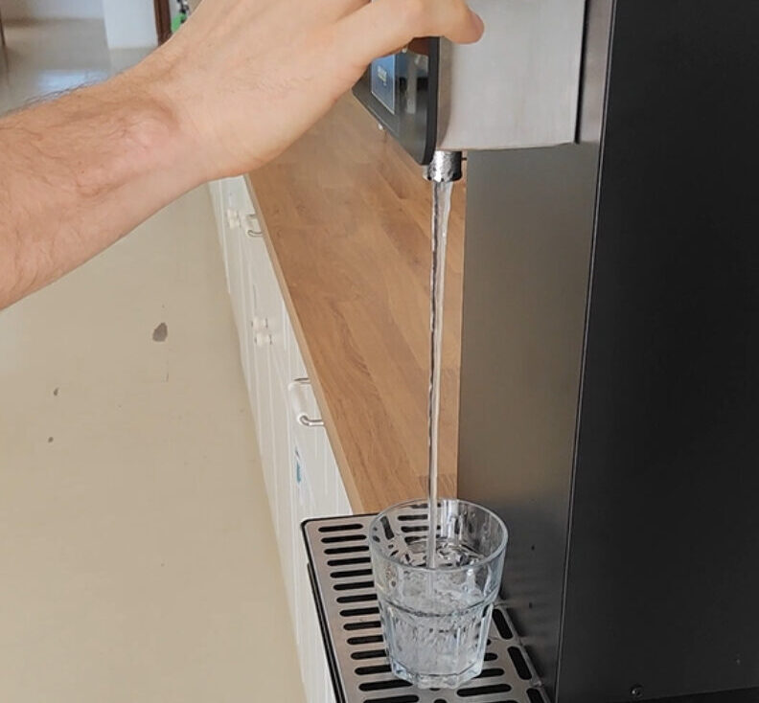
AWARE
IoT applied to responsible water consumption
AWARE is an intelligent reverse osmosis water refill system, based on IoT technology, that enables users to refill reusable containers in a simple, safe and efficient way.
The project has been validated at Urban Hostel Palma, a real tourism environment committed to sustainability.
The solution needed to:
Reduce plastic waste.
Encourage the use of reusable containers.
Control and measure system usage.
Generate real data on consumption habits.
Raise user awareness.
AWARE – Awayter Refill Ecosystem

Slide 3
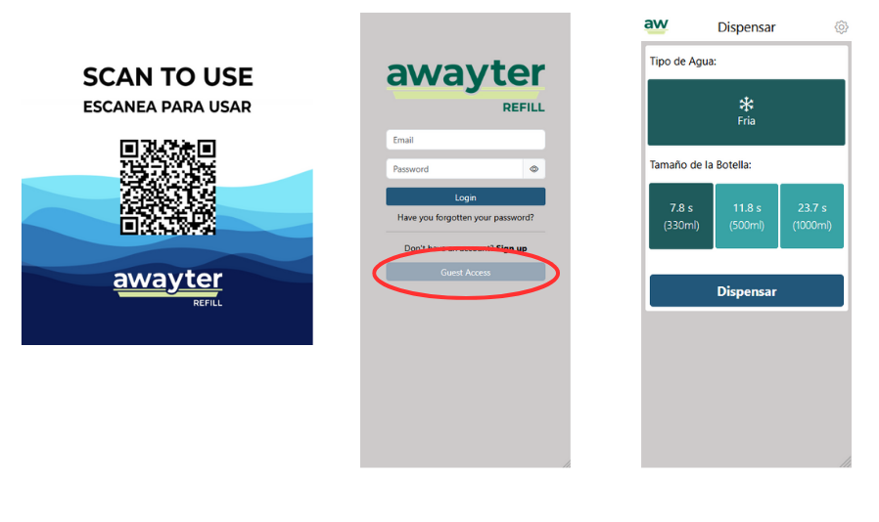

AWARE
Smart water refill system
AWARE combines a reverse osmosis water dispenser with IoT technology and a simple user experience.
For the user:
Access via QR code.
Water refill in reusable containers.
For management:
Real-time monitoring.
Usage traceability.
Environmental impact measurement.
AWARE – Awayter Refill Ecosystem

Slide 4
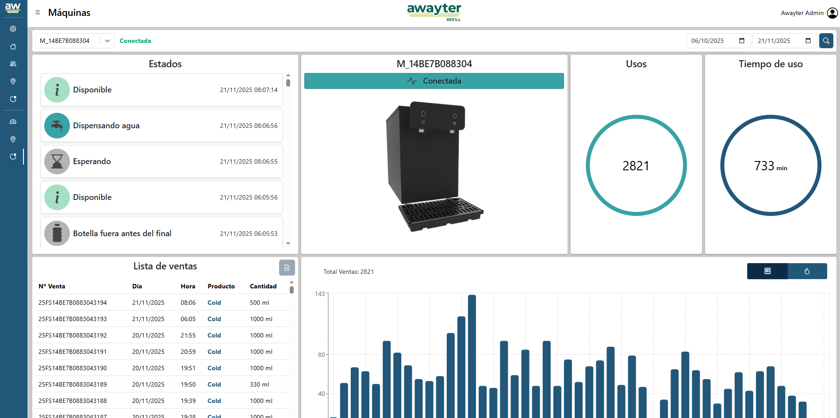
AWARE
Validation at Urban Hostel Palma
The system was implemented at Urban Hostel Palma during a 6-month pilot test.
During this period, the following were monitored:
Number of operations carried out.
Total volume of water consumed.
Use of reusable containers.
Plastic savings generated.
System performance under real conditions.
AWARE – Awayter Refill Ecosystem

Slide 5
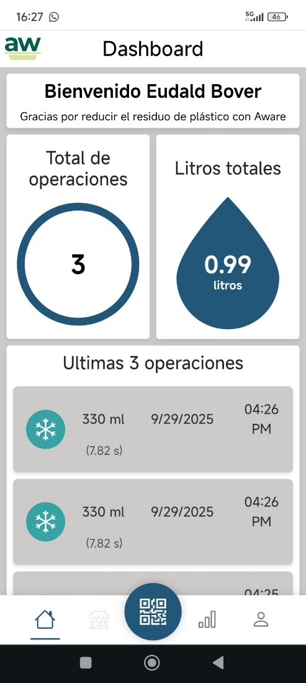
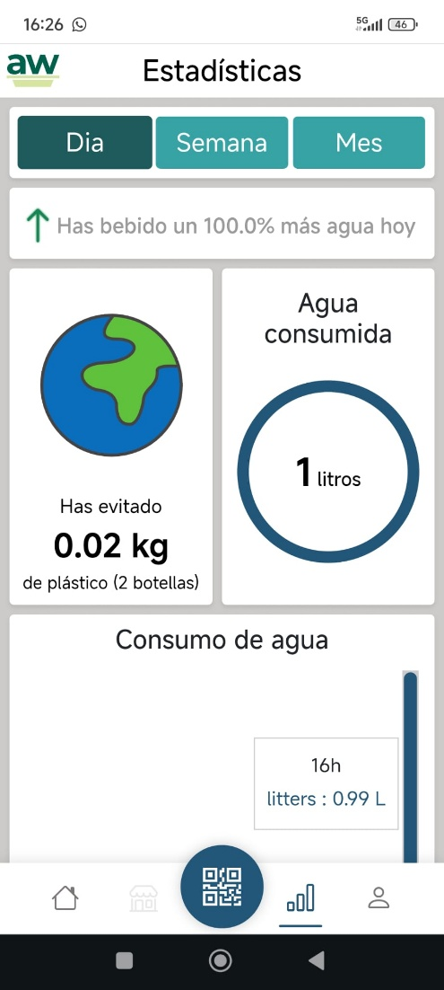
AWARE
Measurable impact and scalable savings
During the pilot test, AWARE achieved tangible results:
15,000 plastic bottles avoided.
9,000 single-use containers saved.
System validation in a real tourism environment.
Objective data to measure environmental impact.
A scalable model for tourism, urban and agri-food sectors.
AWARE – Awayter Refill Ecosystem

