Slide 1

CESAM Final Event • Asclepios Tech • Terracor trials • Challenge C5 • Challenge C6
BOXISTICK®
Mobile Boxilumix® modulated light signaling
for lower waste and longer shelf life
in the context of climate adaptation
From broad experimentation to field-ready scale-up
A patented preventive photobiology technology to activate plants’ natural defenses helping growers reduce waste, cut chemical dependency, and build resilience in a changing climate.
Asclepios Tech/Terracor/IFV • Challenges C5-C6

Slide 2
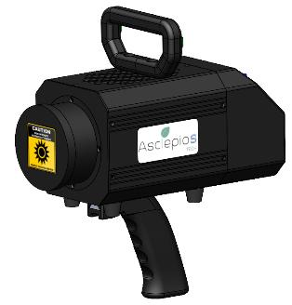
Boxistick® turns Boxilumix® into a mobile field tool
A cordless light-modulation device for orchards, greenhouses, fields and post-harvest applications.
›
Positioning
Patented modulated light signalling approach designed to reinforce natural plant defences
›
A field-deployable preventive tool to reduce fresh produce losses and support lower-input production systems.
No heat, no water, mobile treatment at the point of need
›
Use cases: pre-harvest prevention, post-harvest conservation, maturation management
›
Designed for operational use: cleanable, robust, ergonomic and protocol-driven.
GEN2 route: new specific LEDs, revised Electronics, MMI, weight optimisation, battery integration
Asclepios Tech/Terracor/IFV • Challenges C5-C6

Slide 3


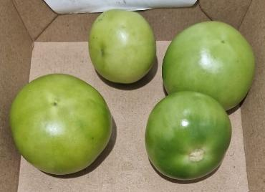
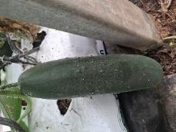
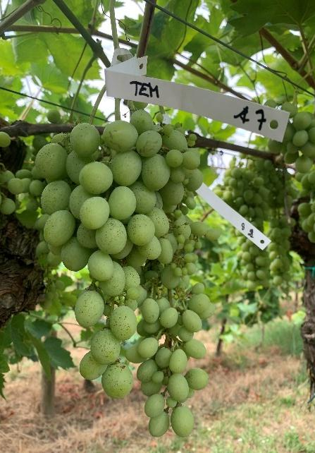
A large experimental effort across Mediterranean crops
Achievement report consolidation: broad scope, pragmatic learning, targeted scale-up.
15
12
≈900
crop protocols prepared
matrices analysed or trialled
experimental units handled
fruit, vegetable and herb matrices
including grape, tomato, cucumber and basil
Terracor + IFV reconstructed effort
Tomato
Cucumber
18
≈500
85d
trial sequences executed
units directly treated
maximum post-harvest follow-up
with observations and photo follow-up
depending on modality compliance
grape conservation monitoring
Grape
Core outcome: credible use-case prioritisation rather than premature universal claims.
Asclepios Tech/Terracor/IFV • Challenges C5-C6

Slide 4

Three use cases deserve immediate controlled confirmation
The strongest signals point to maturation management, preservation and crop-safety windows.
Priority pilots
1. Tomato ripening delay
2. Cucumber storage life
3. Basil safety+disease challenge
Tomato: mature green stage
Cucumber: field application
Basil: Day 15 : 03/10 – Treated 2s
Tomato
Cucumber
Basil
3-day ripening delay
with 37s treatment
Repeated trend of delayed ripening when applied at the mature green stage.
Improved preservation
with 5s treatment
Final control fully rotten while one 5s cucumber remained unaffected.
No disease development
with 2s treatment
Low-dose treatment caused no visible damage on fragile basil leaves.
Asclepios Tech/Terracor/IFV • Challenges C5-C6

Slide 5
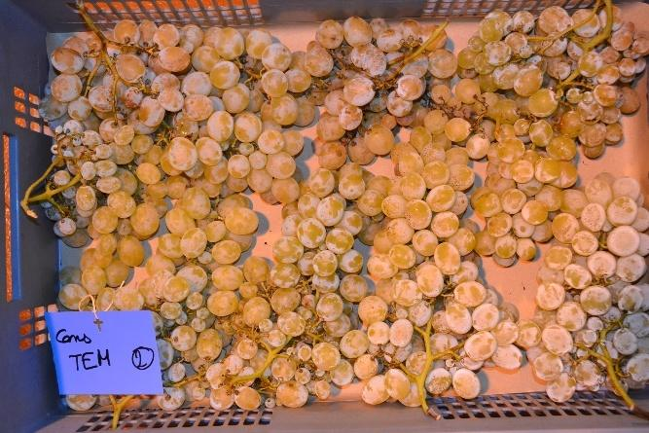
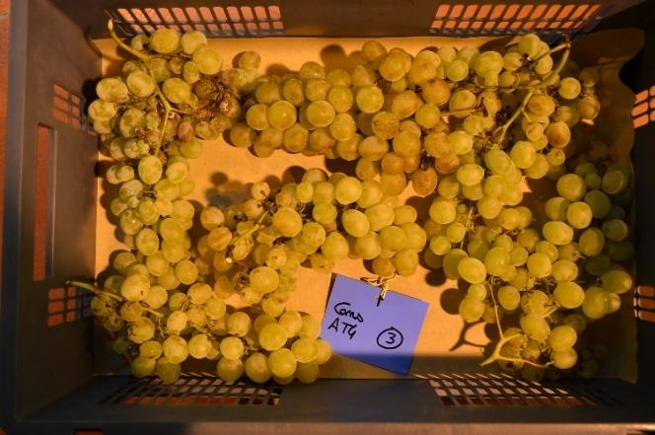
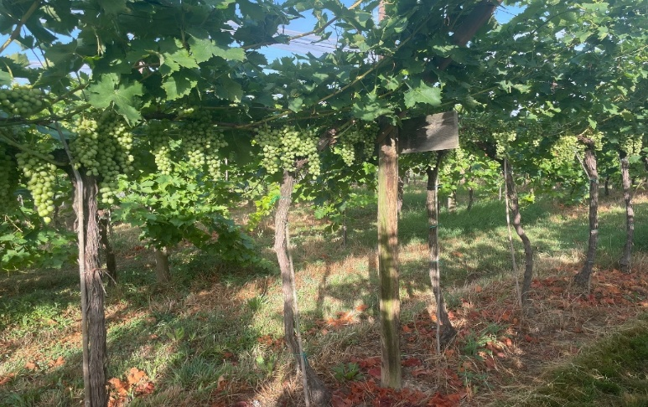
Challenge C6
AT1 and AT4 reduced botrytis pressure on the D2 grape lot
Lot harvested on 25/09/2025 • strongest signal observed during conservation under high botrytis pressure.
Control
AT4
40–85%
85%
Pascal Pelissou
relative botrytis reduction
maximum observed reduction
AT1/AT4 vs control on key dates
AT4 on 05 Nov
›
Commercial window signal: AT4 remained below full non-commercialisation after 50 days, while TEM, AT2 and AT3 reached 100% >10% waste earlier.
Operational signal : AT1 is 5 time more efficient in manpower /AT4
Next step : Boxistick® Gen 2 is 6 time more efficient.
Treatments from veraison, every 15 days.
›
›
Asclepios Tech/Terracor/IFV • Challenges C5-C6

Slide 6
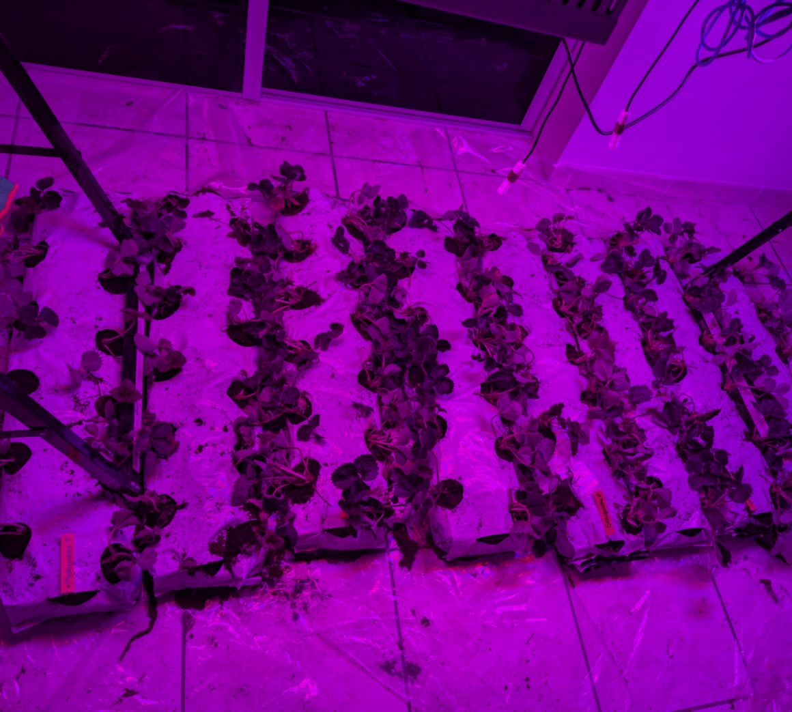
Challenge C5
Boxilumix® shows a strong AT1 fruit-set signal
Compact impact deck | 2025-2026 strawberry growth and production experiment
96
2
AT1
Plants monitored
Strawberries
Cultivars
Mariguette & Gariguette
Priority modality
Boxilumix
x 2.78
x 5.25
AT2
AT1 vs Control on final immature fruits
50 vs 18 fruits
AT1 vs Control on Mariguette
42 vs 8 fruits
Secondary modality
4 fruits vs 3 Control
What is strong
What to do next
• AT1 consistently pushes the crop toward immature fruit formation, especially in Mariguette.
• The effect is visible despite difficult indoor culture conditions, which makes it strategically valuable.
• The result supports a biological modulation hypothesis rather than a final production claim.
• Repeat AT1 under clean crop conditions: pest-free, stable nutrition, randomized positions.
• Measure commercial endpoints: yield per plant, marketable fruit weight, Brix, firmness and shelf-life.
• Keep AT2 as a secondary arm only if the goal is to test ripening or harvest timing.
Core message: AT1 produced the most interesting early fruit-development response; the next step is a clean, yield-oriented confirmation trial.
Asclepios Tech/Terracor/IFV • Challenges C5-C6

Slide 7
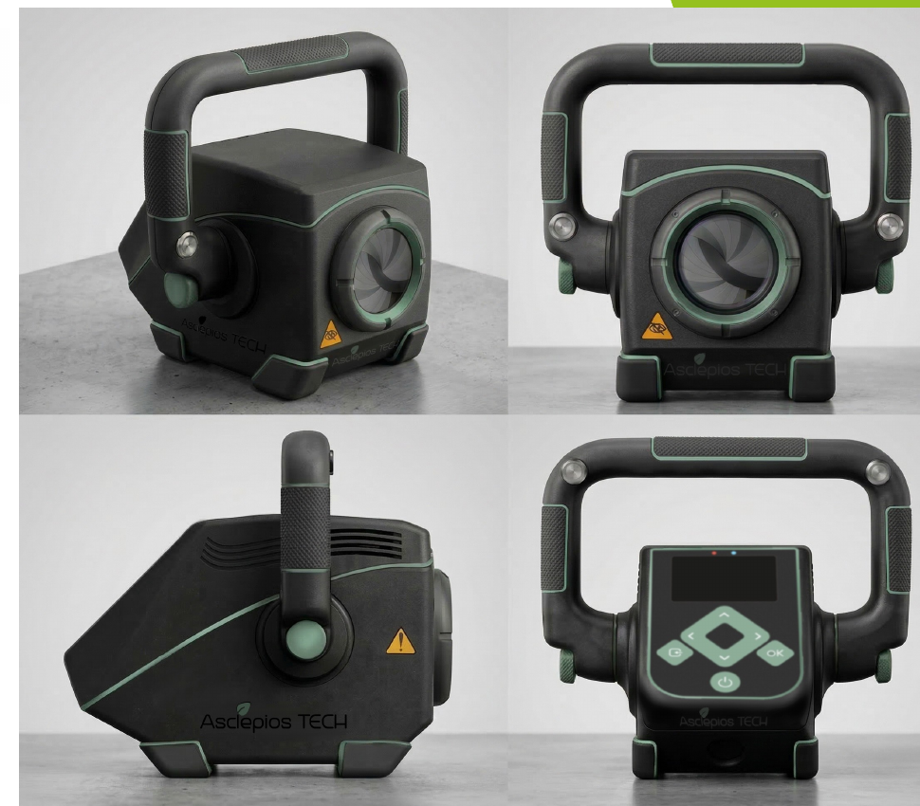
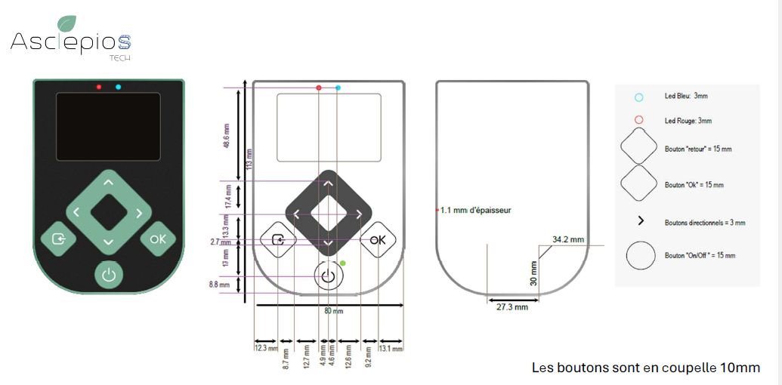
BOXISTICK GEN2: portable electric solution for orchards, open fields and greenhouses
Modulated light treatment to reduce losses and inputs through activation of natural defences.
Loss reduction • Input • reduction Extended shelf life • Field efficiency
Improvement criteria
Above unique PCB, Co-development of the membrane keypad and interface with SERIGRAFIA CIPSADOS, S.L.
›
Perceived robustness
Cleanability
Ergonomics
Precision
Industrialisation
›
›
›
›
6 times more efficient
Boxistick GEN2 : Best combination of field usability, precision and product identity
New generation of LEDs, redesigned electronic boards and drivers, weight optimisation and new product design, battery integration.
A Catalan-Occitania partnership that turns a design concept into a manufacturable solution usable in an agricultural environment.
Life-cycle assessment.
Boxistick integrates the world’s highest concentration of high-power LEDs in a portable photobiology device
Asclepios Tech/Terracor/IFV • Challenges C5-C6
MVP GEN2

Slide 8
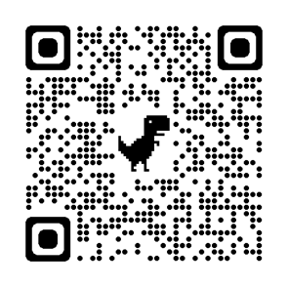
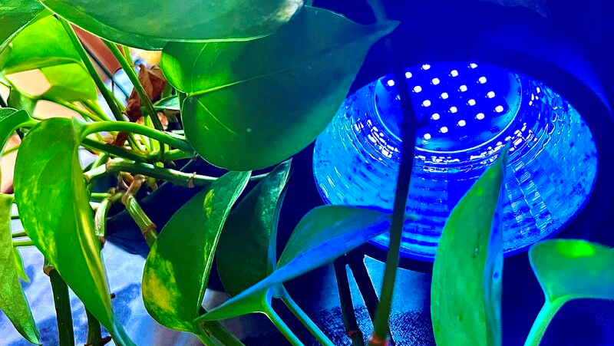
A Farm 2 Fork 2 Health solution
Let’s turn light into resilience
for crops, growers, and the future of food!
Christine ROYNETTE
CEO & CTO
christine.roynette@asclepiostech.com
33 6 86 20 74 88
Asclepios Tech • 68 avenue de Gascogne • 31170 Tournefeuille
Occitanie FRANCE

