Slide 1
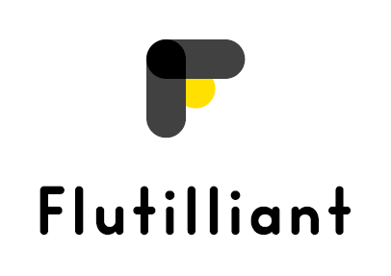


Pyrenees-Mediterranean SUSTAINABLE AGRI-FOOD INNOVATION DAY
2 JULY 2026 – LA CITÉ, TOULOUSE

Slide 2
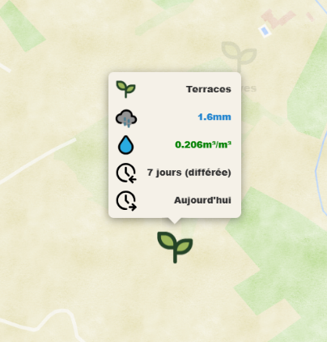
OPEN-SOURCE
IRRIGATION PLATFORM
How much water does your soil really need?
Today, irrigation is still mostly guesswork.
PROJECT ACRONYM

Slide 3
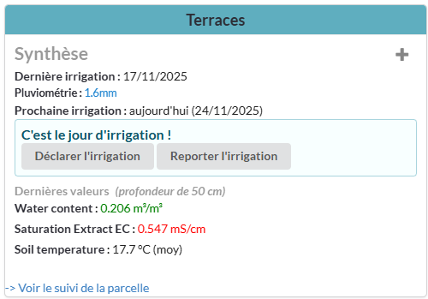
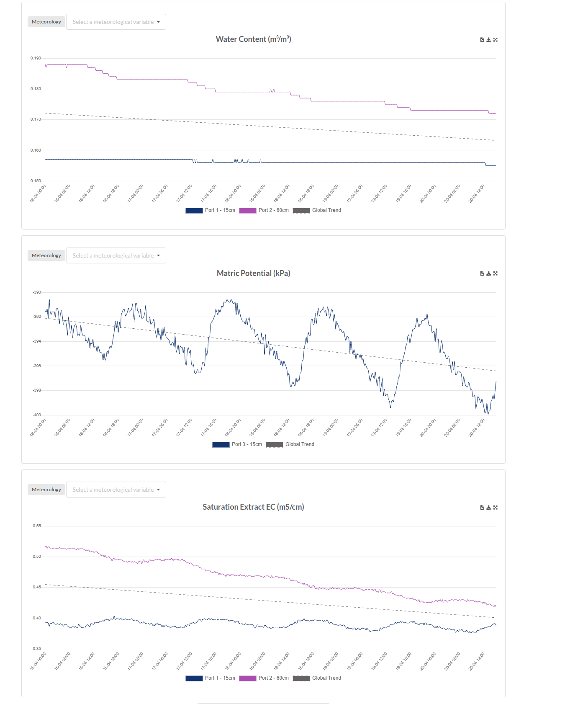
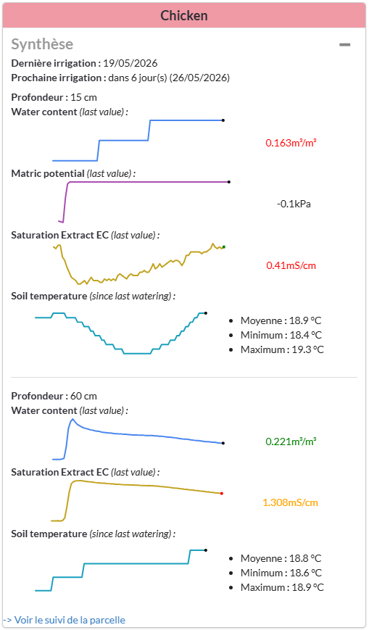



THE PLATFORM
See. Understand. Decide.
Empowerment
know your land from real data, not just by watching.
Your soil sensors
matric potential, ec, moisture, temperature, live
Weather built in
rain, forecasts, evapotranspiration
Irrigation in 2 clicks
you log it, the platform tracks
Low-tech
Free
No expertise needed

Slide 4
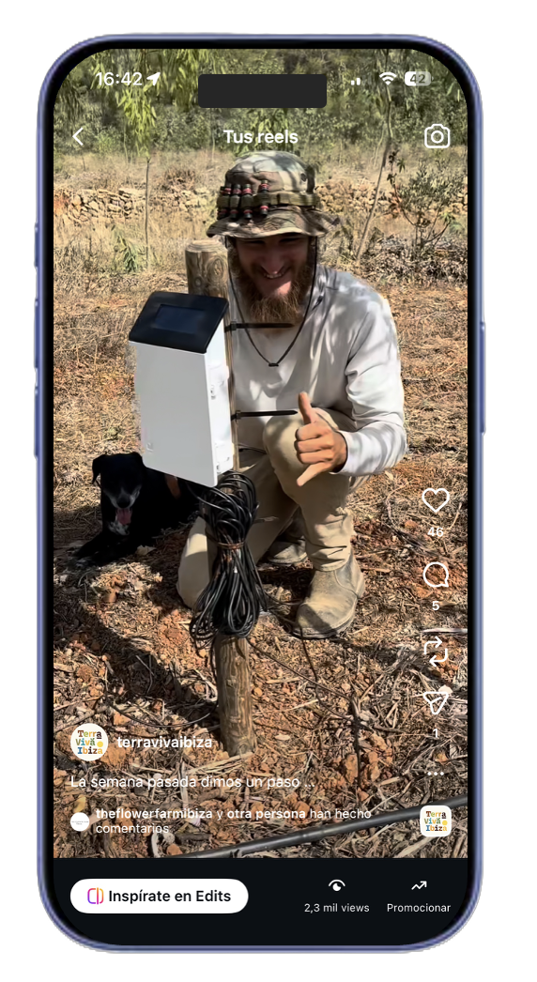


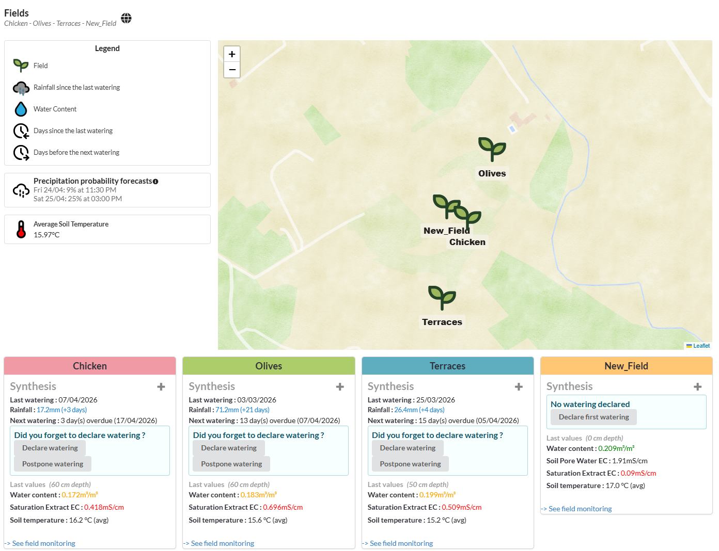
ALREADY IN THE FIELD
Terra Viva farm · Ibiza · EU project CESAM
12
irrigation cycles
saved per field
at end of season
4
plots
12
sensors
24/7
monitoring
Try it on your farm → open-ceres.eu
Simon.bretin@flutilliant.com - 0631719499

