Slide 1
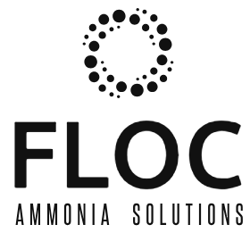
Pyrenees-Mediterranean SUSTAINABLE AGRI-FOOD INNOVATION DAY
NITRO-TIC
Smart IoT and ICT-Based Automated Measurement System for Monitoring and Optimizing Ammonia Nitrogen Recovery
2 JULY 2026 – LA CITÉ, TOULOUSE

Slide 2

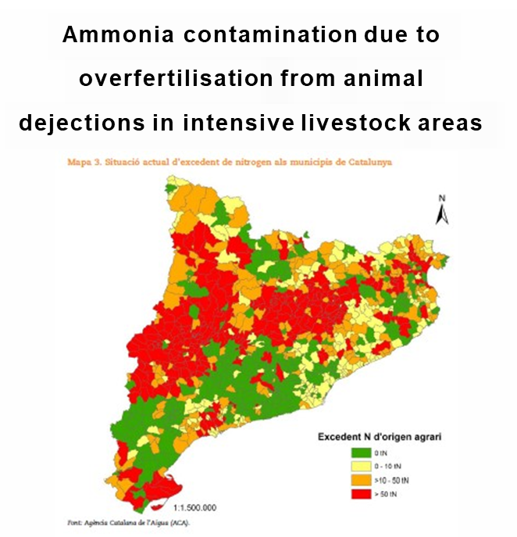
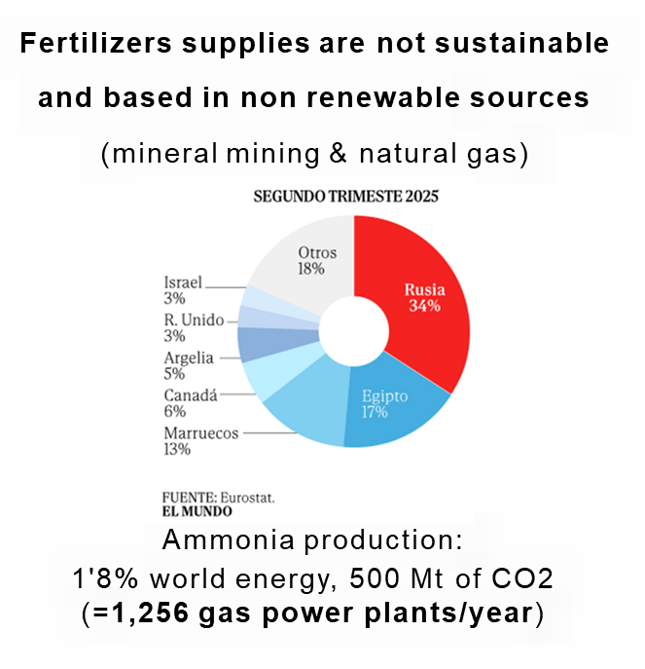
2 PROBLEMS
NITRO-TIC project

Slide 3

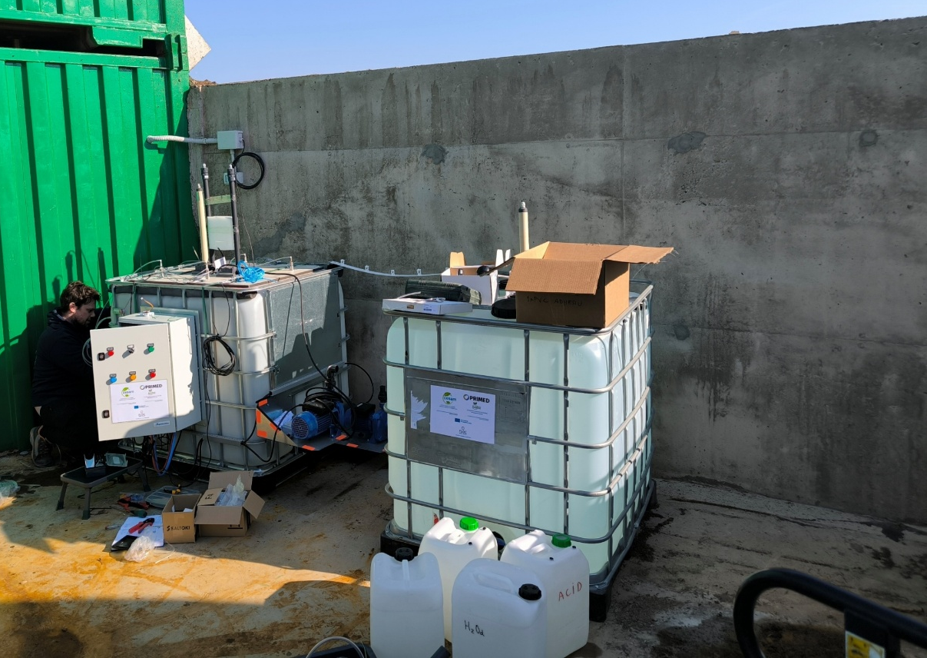
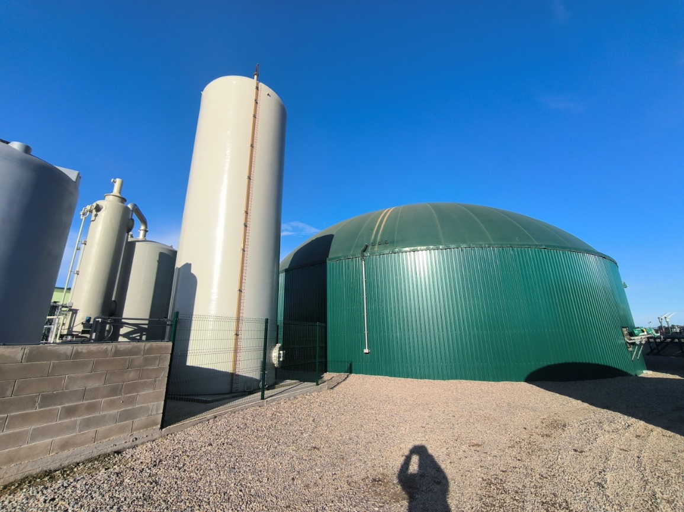
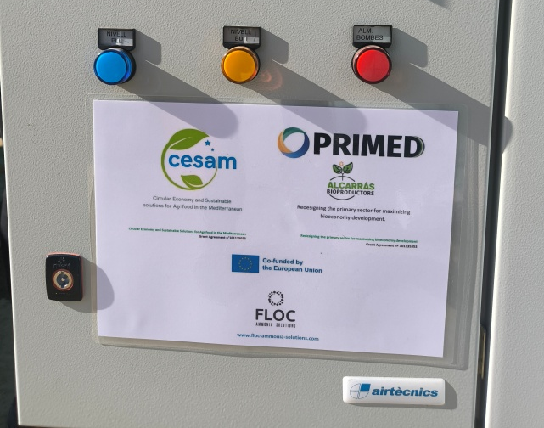
1 SOLUTION
Recovering Nitrogen, Phosphorus and Potassium from digestate and animal dejections and valorising them as inorganic biofertiliser
NITRO-TIC project

Slide 4
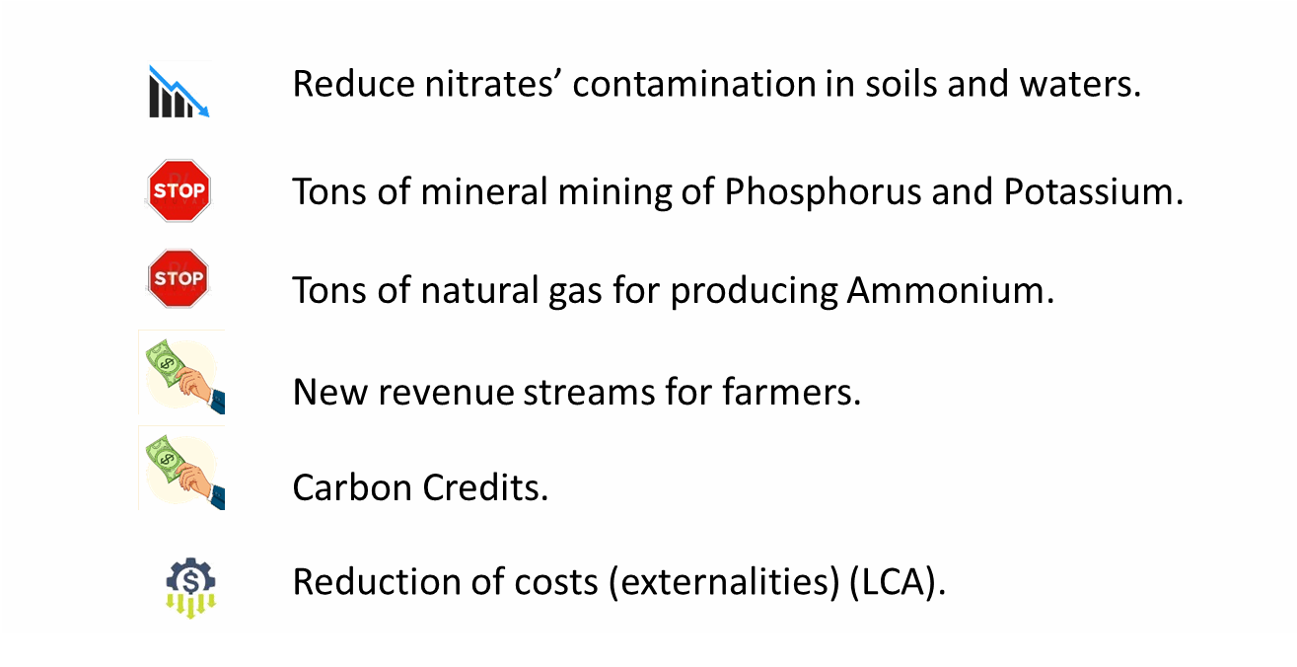
IMPACT
NITRO-TIC project

Slide 5
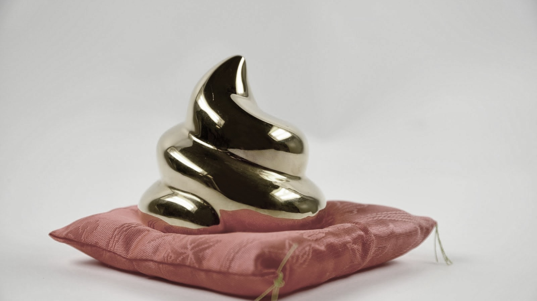
We are the new alchemists!
PROJECT ACRONYM

