Slide 1

Pyrenees-Mediterranean SUSTAINABLE AGRI-FOOD INNOVATION DAY
PROJECT : Bulk dispensing machine
2 JULY 2026 – LA CITÉ, TOULOUSE

Slide 2
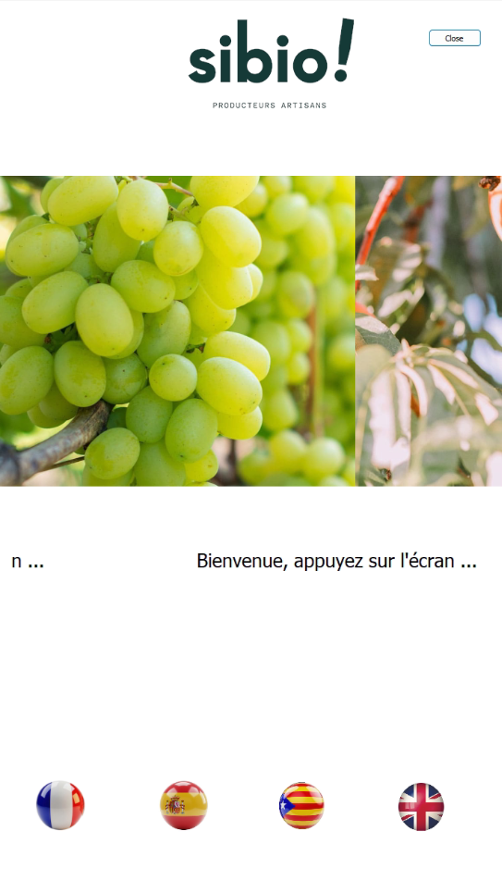

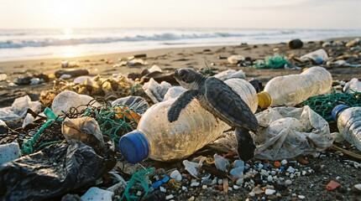
"Don't throw away your used bottles anymore... refill them!“
Objective: to meet European regulatory requirements and REDUCE WASTE on the planet
PROJECT : Bulk dispensing machine

Slide 3

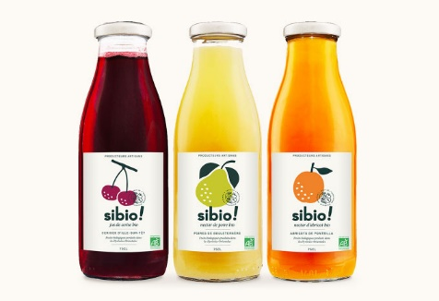
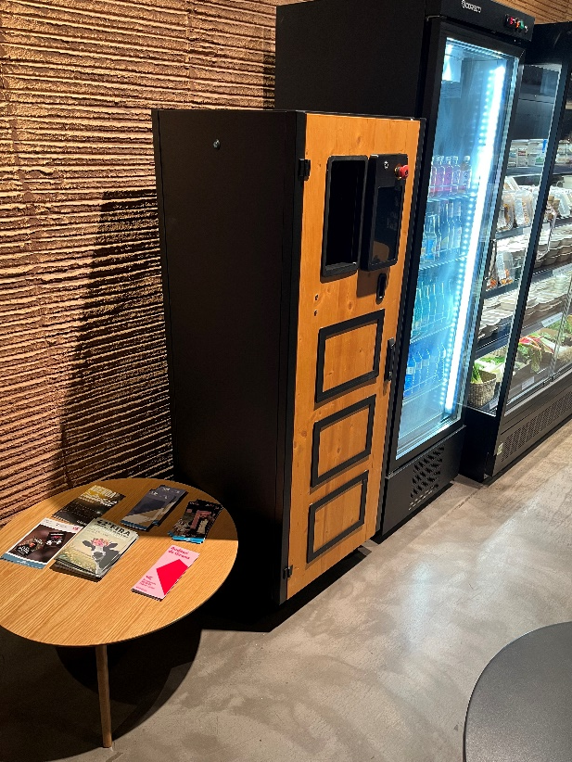

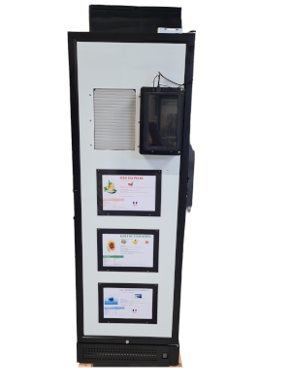
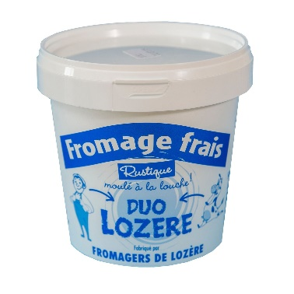
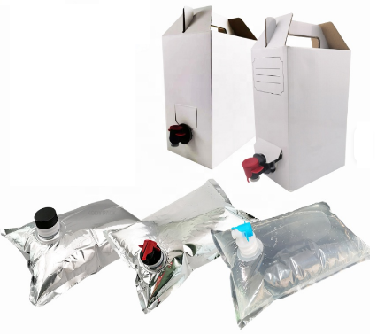

Two market-ready solutions
PROJECT : Bulk dispensing machine

Slide 4
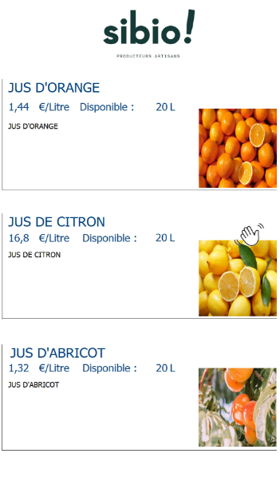
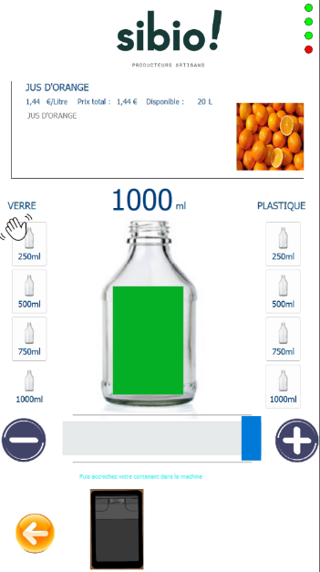
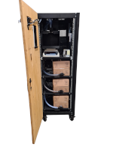
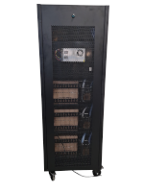
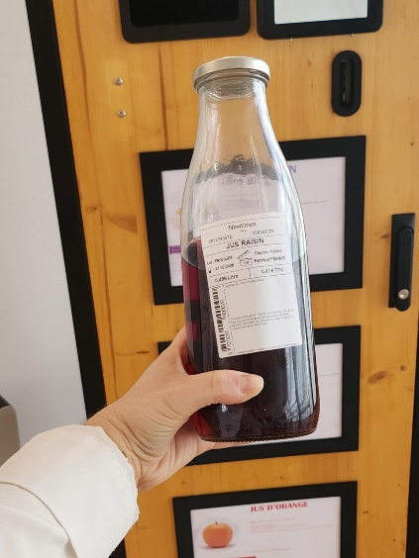
Presentation of room temperature machine
Front view Front interior view Rear interior view
Camera
switch
robotic arm silicone valve
electrical cabinet
Bottle
service location.
Touch screen control.
control computer
Bottle holder Commercial approved scale
service label
labeler
Description sheets for the 3 products
20L boxes of products with quick plug
peristaltic pumps
one per product
PROJECT : Bulk dispensing machine

Slide 5
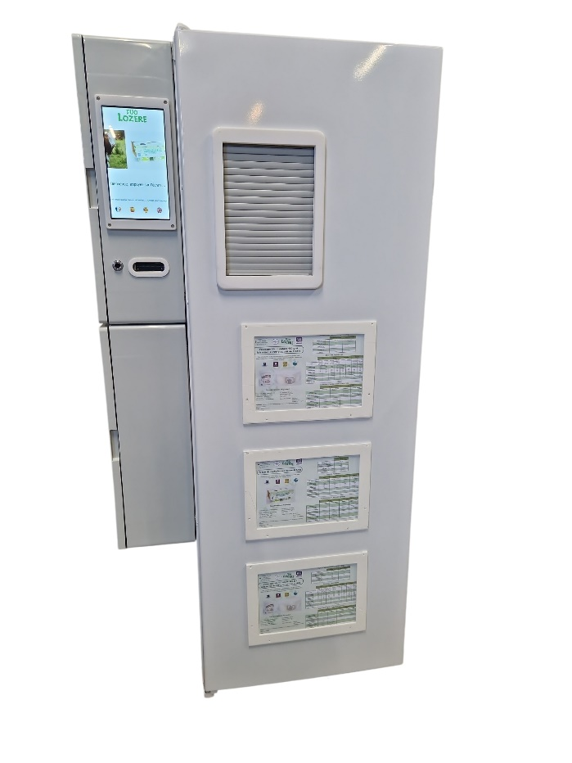
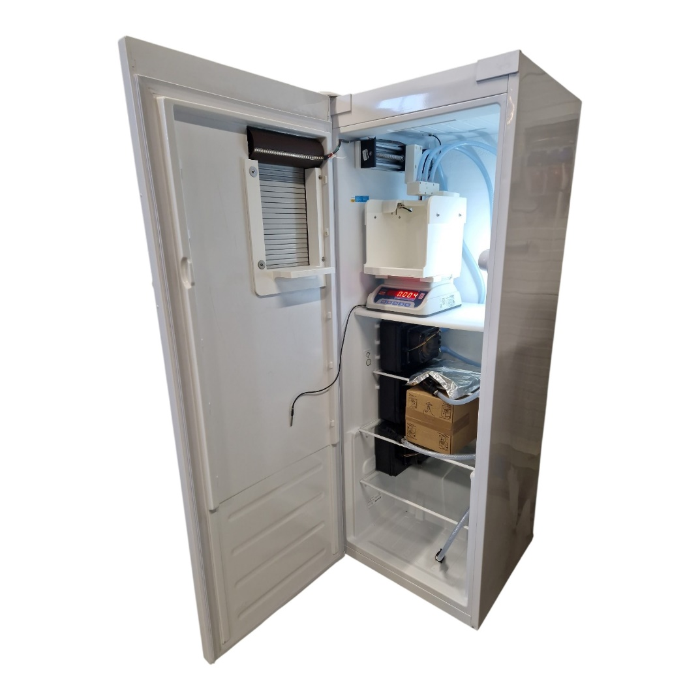
Presentation of cold temperature machine
Front view Front interior view
electrical cabinet
Touch screen control.
robotic arm silicone valve
Service label
Camera
Automatic door.
Bottle holder approved scale
peristaltic pumps
one per product
10L boxes of products with quick plug
Description sheets for the 3 products
Chiller
PROJECT : Bulk dispensing machine

Slide 6
The project in figures
Price offered: €350 per month (room temperature).
Price offered: €420 per month (refrigerated).
More than 600 working days.
A cost of €215,000.
Waste reduction objective:
- Reused at least once.
- 50% less waste in the nature.
2 fully operational models.
A minimum of 5 locations during this year 2026.
Project benefit: 100%.
PROJECT : Bulk dispensing machine

Slide 7
The challenges:
Essential networking
Discover partner companies.
Developing the offer
Benefit from "on-the-ground" experience.
To improve: the tripartite contract is difficult to manage without a leader, particularly regarding planning and progress.
For the project: appoint an operational leader. For each partner: appoint a contact person (not necessarily the CEO).
European aid:
an accelerator
More financial resources to do things faster and more.
Protection
Risk sharing, failure is not a hindrance.
Institutional support (Euroregion, Ad'Occ):
Essential
Enabling small companies to manage European projects.
an opportunity
Learn about existing projects and benefit from a network.
NEWTIMES:
A new range
A new product line leveraging the company's in-house expertise (engineering, software, small-batch production).
A key advantage for the future, enabling larger-scale production.
PROJECT : Bulk dispensing machine

Slide 8
Merci
Thank you
Gracias
Gràcies
Un grand Merci
  À l’Europe
  À l’Eurorégion et à l’Ad’Occ
  À nos nouveaux partenaires
  À nos équipes pour leurs engagements
PROJECT : Bulk dispensing machine

